Slide 1
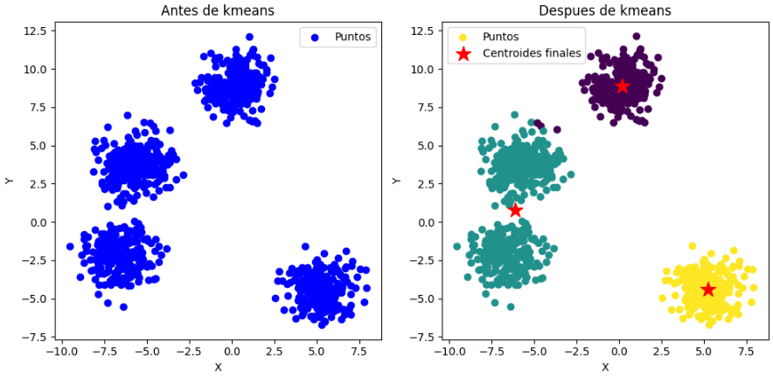
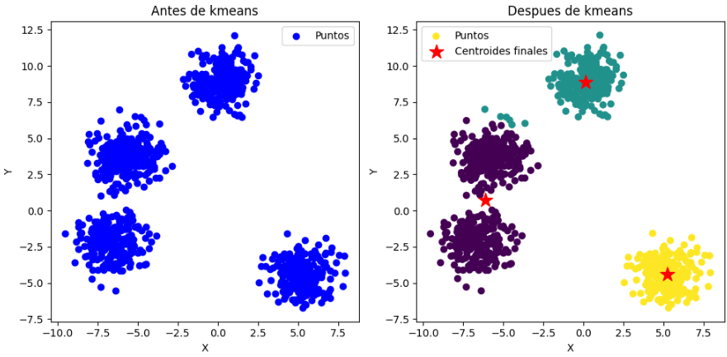
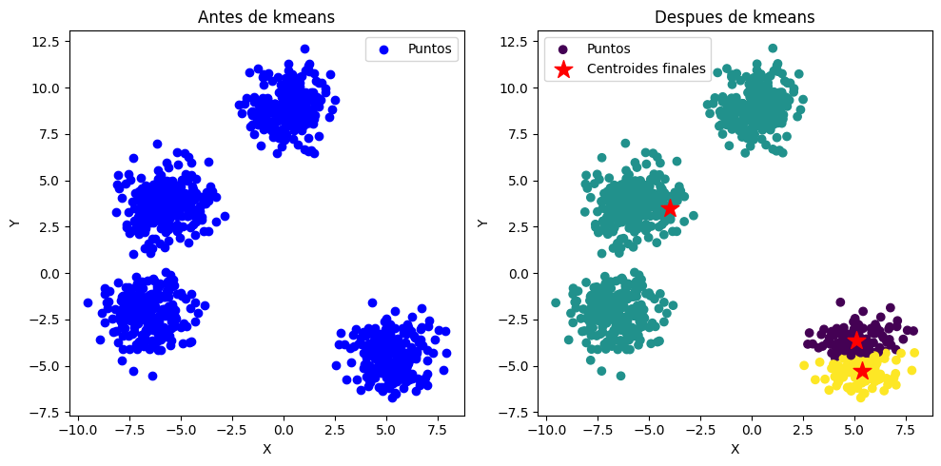
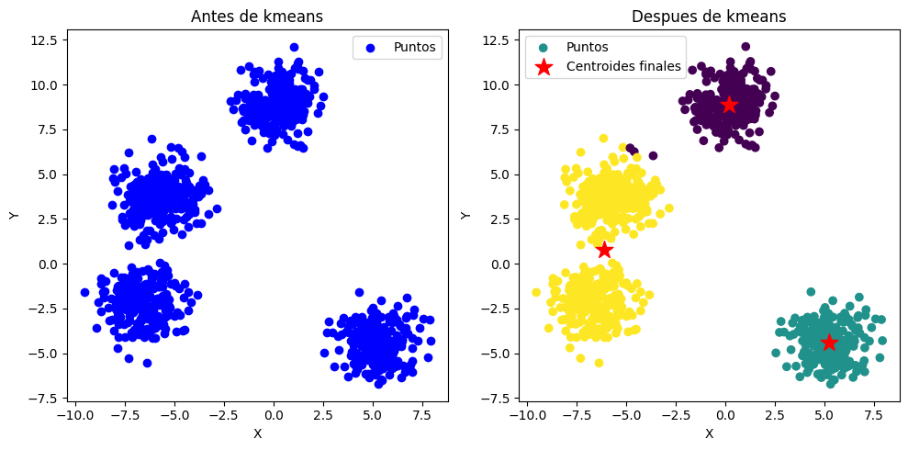
1ER PUNTO - 2D (10 ITERACIONES)

Slide 2
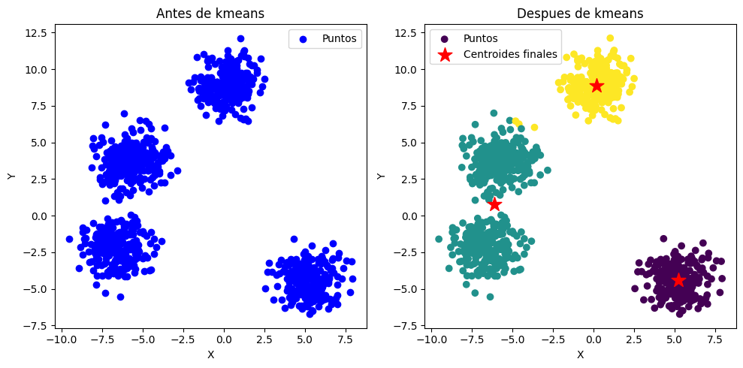

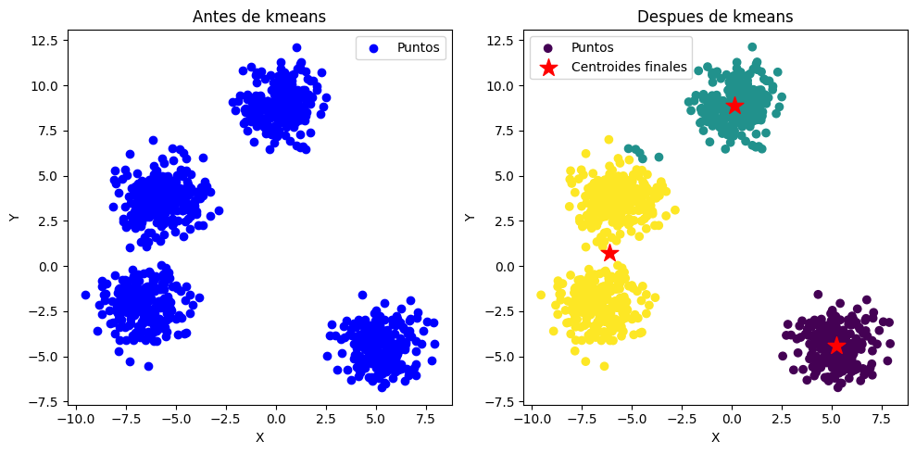
1ER PUNTO - 2D (100 ITERACIONES)

Slide 3
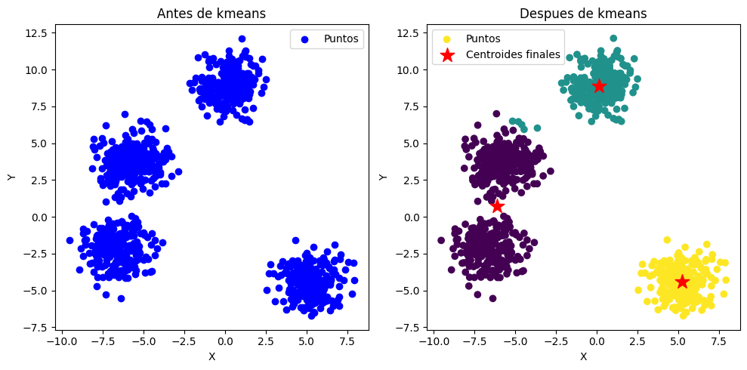
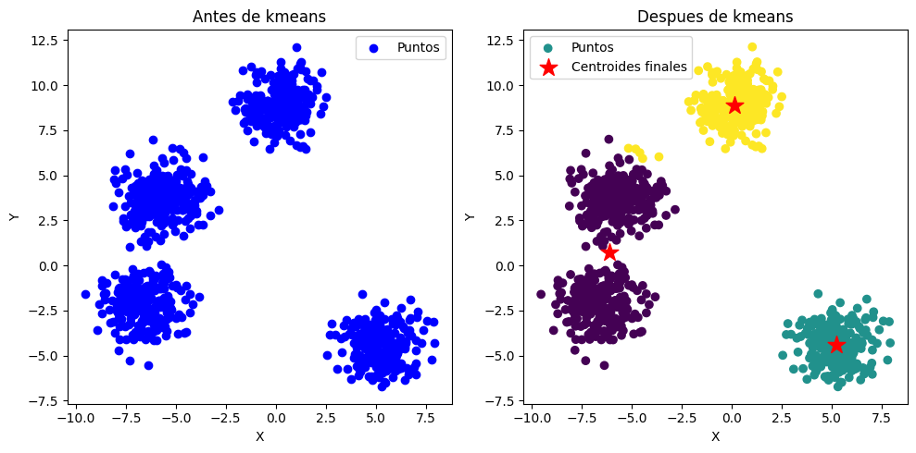
1ER PUNTO - 2D (1.000 ITERACIONES)

Slide 4
1ER PUNTO - 2D (10.000 ITERACIONES)

Slide 5
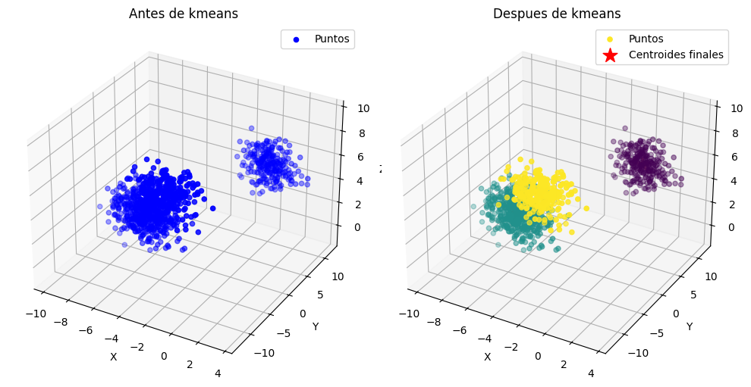
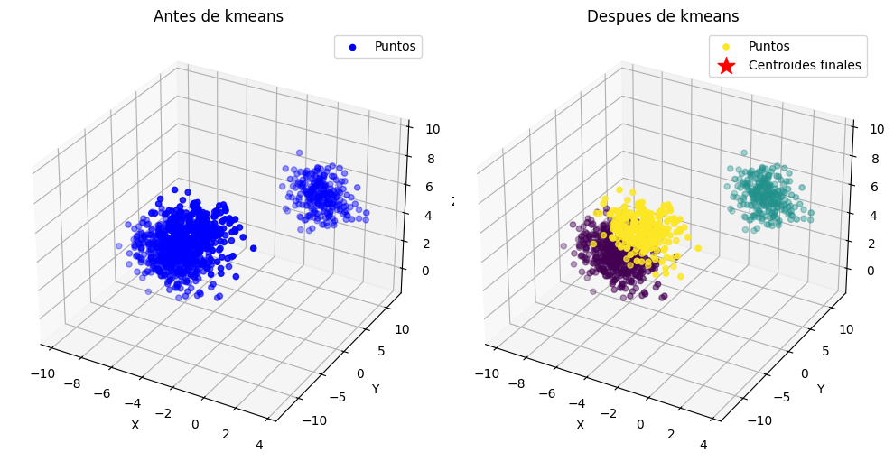
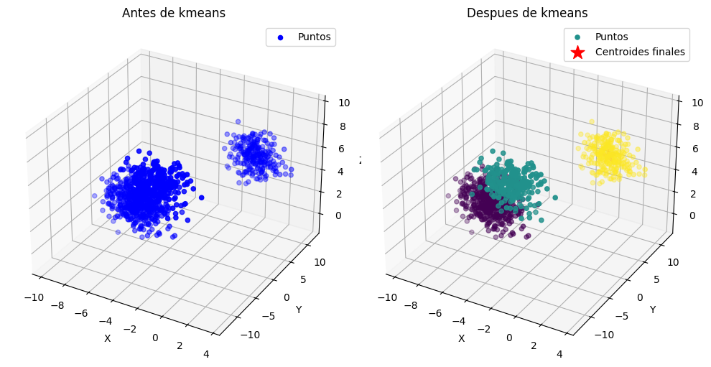
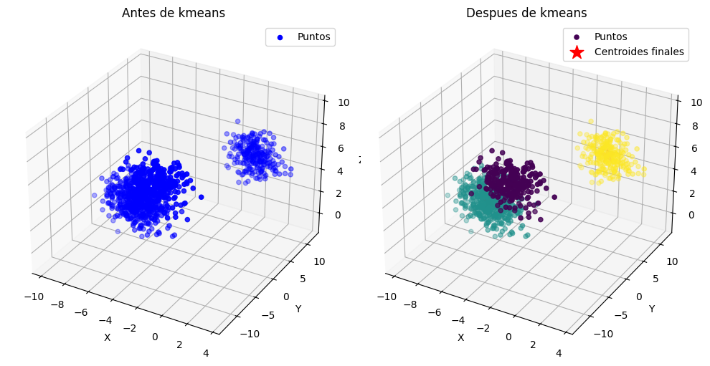
2DO PUNTO - 3D (10 ITERACIONES)

Slide 6
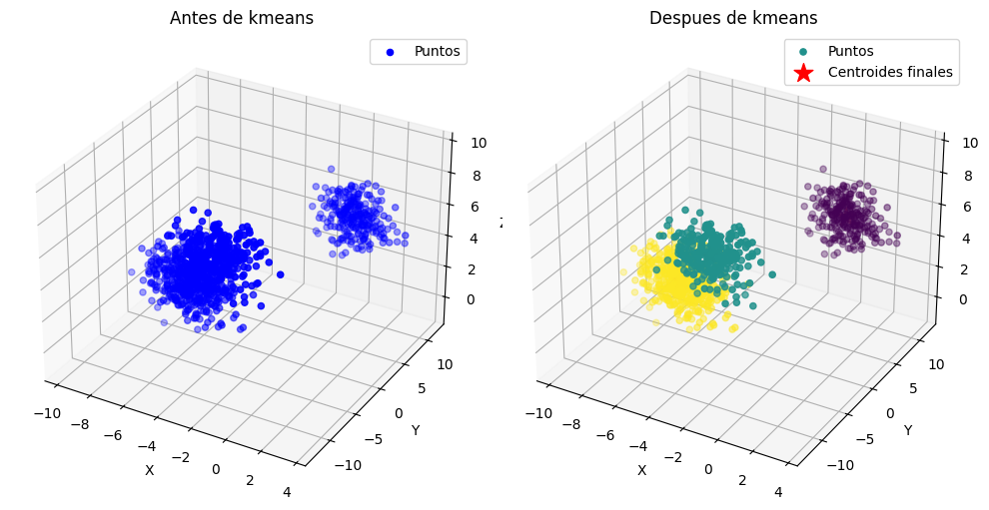
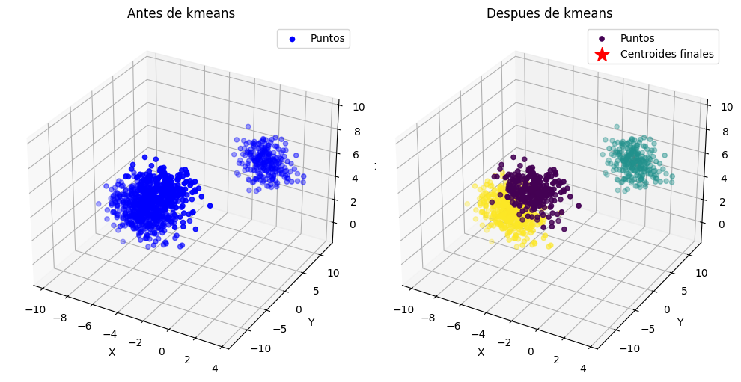
2DO PUNTO - 3D (100 ITERACIONES)

Slide 7
2DO PUNTO - 3D (1.000 ITERACIONES)

Slide 8
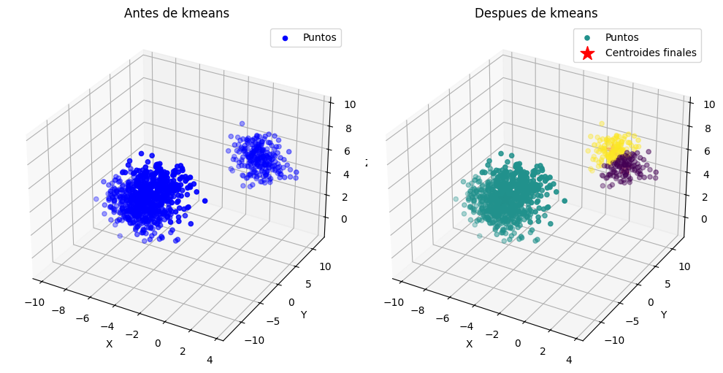
2DO PUNTO - 3D (10.000 ITERACIONES)

Slide 9
4TO PUNTO 100D - 10
[[ 1.69199527e+00 5.12992028e+00 -2.19532504e-03 -4.23459586e+00 -7.76650952e+00 -1.87334800e+00 -3.09210162e+00 4.16526064e-01 -2.37106088e+00 1.08243645e+00 -3.97277248e+00 8.48273158e+00 7.19596081e+00 -1.79000993e+00 1.96374679e+00 5.69681308e-01 7.94649549e+00 -4.83042432e-01 -1.45968726e+00 -4.37956628e+00 4.60707214e+00 4.51616831e-01 -2.64519458e+00 -6.06092485e+00 2.47598175e+00 -4.62990129e+00 2.77630385e+00 1.84607260e+00 1.54832850e+00 -2.29557751e+00 3.13004338e+00 1.07327710e+00 -5.49855635e+00 1.31268443e+00 -7.74551743e+00 -9.02639944e+00 3.05746003e-01 4.26736673e+00 -7.90322264e-01 7.03942772e-01 -2.90612677e+00 7.75831512e+00 5.45609707e+00 5.20522684e+00 -2.62117639e+00 -4.68885180e+00 -3.06197276e+00 1.79161387e+00 -3.63911543e+00 5.62907359e+00 6.31240215e+00 7.49320928e-01 6.16687897e+00 7.54231838e+00 -6.81916543e+00 -8.07410646e+00 -4.21233324e+00 1.67108664e+00 -2.98707269e+00 -3.24837025e+00 3.66037300e+00 -1.86990522e+00 6.30354807e-01 -6.50567613e+00 -2.42769134e+00 7.98777577e+00 -3.67611294e+00 5.62743747e-01 8.84681006e+00 -5.74272989e+00 -7.54498001e+00 -4.54539119e-01 2.23601164e+00 -8.50239356e-02 -6.97173002e+00 3.78533896e+00 -2.99570955e+00 -1.64830199e+00 -4.65513429e+00 1.55318090e+00 4.42232361e+00 -2.15086759e+00 5.65852513e-01 -1.10450755e+00 -2.98759965e+00 -3.73388558e+00 -1.70176850e+00 -8.06488283e-01 3.92907375e+00 -1.90160109e+00 -2.10998164e+00 -2.60179564e-01 3.78367898e-02 1.69065747e+00 3.85438933e+00 -5.20688325e+00 3.61570704e-01 -8.53295253e-01 7.04171408e+00 -2.97061947e+00] [-8.71621835e+00 4.53161461e+00 -7.44302405e+00 6.15343802e+00 8.72622635e+00 -2.99432635e+00 -3.98433715e+00 1.95698099e+00 3.76940599e+00 -9.06212749e+00 2.41035096e+00 -6.59356349e+00 -8.23289943e+00 -3.78196315e+00 -1.80155015e+00 -1.93029010e+00 4.39269882e+00 7.48881321e-02 -3.18545598e+00 -7.47934955e-01 9.07099746e-01 6.63209481e+00 -3.30410725e+00 5.77502722e+00 3.12859188e+00 7.49360535e+00 -1.70624566e+00 -6.67798644e+00 -8.20647280e+00 1.04536068e+00 9.37971090e+00 -4.36765572e+00 -2.21928816e+00 6.19259051e+00 -1.98896895e+00 7.54231995e+00 -9.51987748e+00 7.82889446e+00 -4.26283341e+00 9.75381518e+00 5.71546328e+00 6.11273445e+00 -6.13895744e-01 -3.54868073e+00 -3.49895913e+00 7.87874975e+00 -1.46777728e+00 -9.82375744e+00 2.33025194e+00 2.45272194e+00 2.42741881e+00 -8.31677872e+00 -6.59246622e+00 5.42683337e+00 1.88911699e+00 3.56489028e+00 -8.33329486e+00 1.38715708e+00 -4.85687291e+00 -5.82037759e+00 -7.82958157e+00 -7.95812397e+00 -4.97350986e+00 5.19026733e+00 1.71210896e+00 1.10126947e+00 -2.46033111e+00 -5.10129861e+00 1.82082882e+00 6.90154882e+00 -3.73421190e-01 -8.37920805e+00 8.44377917e+00 -2.29440351e-01 -7.67514379e+00 6.55086399e+00 -2.45130365e+00 -7.93202017e+00 9.11873990e+00 -2.96994300e+00 -5.49586941e+00 -8.29450617e-01 -9.60171400e+00 -5.04892469e+00 2.83307156e+00 -3.09594636e+00 -9.16220106e+00 -4.55086607e+00 9.27108949e+00 4.22786226e+00 2.22414928e+00 -9.02500286e+00 9.69004882e+00 1.00654815e+00 1.78668541e-01 6.16182845e+00 4.31902709e+00 6.53723217e+00 -7.13058900e+00 1.67872789e+00] [-8.77554273e+00 4.60420614e+00 -7.66608882e+00 6.12242913e+00 8.85877166e+00 -3.19458537e+00 -3.62363708e+00 2.03450962e+00 3.91668247e+00 -9.12513623e+00 2.55835383e+00 -6.41207064e+00 -8.49659617e+00 -3.66575401e+00 -1.75064651e+00 -2.35412618e+00 4.58628422e+00 4.01409681e-01 -3.02873787e+00 -7.13175506e-01 9.22811737e-01 6.66344921e+00 -2.88565271e+00 5.65835606e+00 2.89801927e+00 7.46571035e+00 -1.90334358e+00 -6.24403993e+00 -8.05313343e+00 1.23536414e+00 9.76025143e+00 -3.97874987e+00 -2.27501778e+00 6.47805436e+00 -2.18660215e+00 7.94988017e+00 -9.50805582e+00 7.93712829e+00 -4.11233886e+00 9.50593385e+00 5.41026395e+00 6.34078800e+00 -5.84110136e-01 -4.24670286e+00 -3.43317481e+00 7.75646422e+00 -1.40780621e+00 -9.99726297e+00 2.42788625e+00 2.94628430e+00 1.91084132e+00 -8.30788139e+00 -6.12324794e+00 5.41317101e+00 1.85347036e+00 3.71761020e+00 -8.78595570e+00 1.08099627e+00 -4.75023780e+00 -5.56874350e+00 -7.60873806e+00 -7.96620781e+00 -5.23952651e+00 4.92382424e+00 1.89376799e+00 5.58425805e-01 -2.54061482e+00 -5.44947011e+00 1.78434721e+00 6.64622256e+00 -4.47106449e-01 -8.32573579e+00 8.83292381e+00 -3.39193405e-01 -7.34321983e+00 6.75559706e+00 -2.40681493e+00 -7.68598318e+00 9.08460372e+00 -3.20791679e+00 -5.92228872e+00 -7.73129370e-01 -9.36756640e+00 -5.00283594e+00 3.22346132e+00 -3.34623939e+00 -9.69095208e+00 -4.44276744e+00 8.98467423e+00 4.32698890e+00 2.42142440e+00 -9.41203691e+00 9.78182209e+00 8.97675326e-01 3.41426456e-01 6.25439570e+00 4.36831413e+00 6.51382699e+00 -7.13110354e+00 1.96345829e+00]]
[[ 0.42302977 8.71888562 5.34844977 -4.31302371 -5.70741231 3.68093336 -6.59444369 -2.00770977 2.38817635 -1.67498351 -10.12121847 7.62918201 7.74508938 -3.94533674 1.7071894 9.55097059 6.77201453 -8.78787645 -4.19137268 -4.39579896 6.46425183 2.41279571 -7.83828783 -9.98819764 8.84674268 -7.26434822 -1.4068071 -2.98151687 7.25002741 -1.379587 6.41104252 4.47141177 -7.5432676 2.00699988 -7.2109818 -8.56238008 6.78552503 -0.49489926 -6.88755905 0.84637328 1.58883983 5.59860049 3.24073918 1.13844279 -6.59164298 -5.2258992 0.02023503 -2.19116311 -0.3105788 9.2119773 7.90647821 0.24037536 6.35493301 6.39730927 -5.33129201 -8.37122117 -0.4836382 7.54656411 -7.04113262 -5.45229979 8.30402073 -7.38597154 8.33203368 -5.267079 2.38923625 9.11758315 -4.829028 -1.1825553 9.30266033 -5.15940151 -5.9767149 3.7988361 6.9304247 -1.00525418 -7.88066897 2.41718794 -8.30889165 -8.6951581 -3.15582754 8.17995429 6.0456578 -2.38823748 -7.85635275 -7.36417718 0.72349204 0.08062656 -0.16834576 -7.32213843 5.80620162 1.85414355 5.21107044 -0.76827979 -8.70336274 2.09239003 -1.16859998 -10.02788379 -9.04406197 -1.67925452 7.37292318 -1.54051733] [ -2.89969364 2.99816975 -6.37706646 1.04177682 -0.53457135 -5.27309658 -1.60442618 2.42999711 -1.61975173 -2.64221194 2.27189721 1.39043093 -0.80906177 -1.66308344 0.16257697 -5.29223645 6.78250137 4.07656714 -0.95667646 -2.57279524 1.85165968 2.53112771 -0.24823203 1.81517914 -0.45649748 2.73954893 2.61371027 0.18832226 -6.2220273 -1.05407479 4.63509289 -3.20565891 -2.84237092 3.49033717 -5.1327222 -0.86165883 -7.81097718 8.56470549 0.51664955 4.98087286 -1.02548034 8.12578795 3.58383161 2.64265206 -1.09008684 1.83813287 -3.86272867 -2.15467478 -2.2673168 2.42932477 3.42390416 -3.51623951 -0.18161472 7.00583105 -3.22954902 -2.03793017 -8.18611216 -1.5403431 -1.89441063 -3.42175886 -4.40290908 -2.1435647 -6.09410864 -1.3317978 -2.68451205 3.84730624 -2.46926049 -1.5683121 5.00516872 0.22658886 -4.71975481 -6.54024181 3.15199664 0.22071655 -6.71645565 5.95956936 -0.04163776 -1.07512598 1.46364778 -4.05507067 -1.45471698 -1.38953677 -0.14584046 0.15476743 -1.80258379 -5.41876576 -6.41933649 0.70208427 5.61368067 -0.69090147 -3.53686807 -4.47488652 9.24183634 1.15329108 4.66774164 2.89192094 7.07879538 3.20187913 -0.26931033 -1.34555145] [ 0.45273665 8.99564112 4.8595907 -4.57778752 -5.59545433 3.64429859 -6.93460968 -2.02715787 2.27238439 -1.59419919 -9.74049395 7.81853486 7.41626514 -3.97854776 2.02354416 9.44307211 6.94913779 -8.86977541 -3.92992924 -4.25563533 6.35747467 2.59822084 -7.81067844 -10.11007906 8.81424229 -7.23922358 -1.61327287 -3.23866768 7.65509246 -1.2407879 6.86689346 4.33437894 -7.58419752 2.01260445 -7.52799256 -8.50617879 6.57309032 -0.97573696 -6.5827254 1.35607311 2.00705691 5.40863299 3.02556649 1.20079861 -6.38344019 -5.28204013 0.37544151 -1.77195491 -0.44489714 9.03630258 7.85158101 0.19223932 6.44338839 6.64354898 -5.29350772 -8.47780475 -0.96104544 7.69583339 -6.84911339 -5.10235619 8.59071682 -7.41926319 8.22630339 -5.40975466 2.21968367 8.94177394 -5.05730336 -0.8385541 9.75130895 -5.24791958 -6.22087818 3.83209963 6.68953817 -0.75250263 -8.13281546 2.20056403 -8.32775993 -9.23014242 -3.12633398 7.93180499 5.91379432 -2.20868988 -8.24471343 -7.75874056 0.63869998 0.1541676 0.12011319 -7.72680472 5.5928685 1.85785071 5.1230963 -0.92399008 -8.53280574 1.89388814 -1.58518616 -9.86892364 -9.07703223 -1.44123454 7.66865838 -1.1913997 ]]

Slide 10
4TO PUNTO 100D - 1000
[[ 1.69199527e+00 5.12992028e+00 -2.19532504e-03 -4.23459586e+00 -7.76650952e+00 -1.87334800e+00 -3.09210162e+00 4.16526064e-01 -2.37106088e+00 1.08243645e+00 -3.97277248e+00 8.48273158e+00 7.19596081e+00 -1.79000993e+00 1.96374679e+00 5.69681308e-01 7.94649549e+00 -4.83042432e-01 -1.45968726e+00 -4.37956628e+00 4.60707214e+00 4.51616831e-01 -2.64519458e+00 -6.06092485e+00 2.47598175e+00 -4.62990129e+00 2.77630385e+00 1.84607260e+00 1.54832850e+00 -2.29557751e+00 3.13004338e+00 1.07327710e+00 -5.49855635e+00 1.31268443e+00 -7.74551743e+00 -9.02639944e+00 3.05746003e-01 4.26736673e+00 -7.90322264e-01 7.03942772e-01 -2.90612677e+00 7.75831512e+00 5.45609707e+00 5.20522684e+00 -2.62117639e+00 -4.68885180e+00 -3.06197276e+00 1.79161387e+00 -3.63911543e+00 5.62907359e+00 6.31240215e+00 7.49320928e-01 6.16687897e+00 7.54231838e+00 -6.81916543e+00 -8.07410646e+00 -4.21233324e+00 1.67108664e+00 -2.98707269e+00 -3.24837025e+00 3.66037300e+00 -1.86990522e+00 6.30354807e-01 -6.50567613e+00 -2.42769134e+00 7.98777577e+00 -3.67611294e+00 5.62743747e-01 8.84681006e+00 -5.74272989e+00 -7.54498001e+00 -4.54539119e-01 2.23601164e+00 -8.50239356e-02 -6.97173002e+00 3.78533896e+00 -2.99570955e+00 -1.64830199e+00 -4.65513429e+00 1.55318090e+00 4.42232361e+00 -2.15086759e+00 5.65852513e-01 -1.10450755e+00 -2.98759965e+00 -3.73388558e+00 -1.70176850e+00 -8.06488283e-01 3.92907375e+00 -1.90160109e+00 -2.10998164e+00 -2.60179564e-01 3.78367898e-02 1.69065747e+00 3.85438933e+00 -5.20688325e+00 3.61570704e-01 -8.53295253e-01 7.04171408e+00 -2.97061947e+00] [-8.58412984e+00 4.37072246e+00 -7.54828903e+00 6.33536734e+00 8.80123292e+00 -3.31373952e+00 -3.71859812e+00 2.08583603e+00 3.91703103e+00 -9.16377181e+00 2.71853561e+00 -6.55905101e+00 -8.30279359e+00 -3.69730928e+00 -1.60951935e+00 -1.85026014e+00 4.22269246e+00 3.28038545e-01 -3.03317193e+00 -7.73103771e-01 1.00003355e+00 6.75100155e+00 -3.01750710e+00 5.86626451e+00 3.07510277e+00 7.59698240e+00 -1.84858373e+00 -6.26559620e+00 -7.80798962e+00 1.11177331e+00 9.59994576e+00 -4.06135520e+00 -2.28089069e+00 6.39820003e+00 -2.05892212e+00 7.97905217e+00 -9.18221056e+00 8.06063605e+00 -4.34782074e+00 9.54782560e+00 5.56620263e+00 6.29436417e+00 -6.31473231e-01 -3.81690918e+00 -3.37098905e+00 7.74135074e+00 -1.57977229e+00 -1.00983037e+01 2.30591315e+00 2.57659171e+00 1.84088504e+00 -8.25742844e+00 -6.32968883e+00 5.27865225e+00 2.00239520e+00 3.65576457e+00 -8.66952800e+00 1.18665598e+00 -4.83498984e+00 -5.52856346e+00 -7.68717722e+00 -7.85784884e+00 -5.15805350e+00 4.96888696e+00 2.04517058e+00 7.19653999e-01 -2.52289155e+00 -5.72792243e+00 1.82180544e+00 6.77864393e+00 -3.64074313e-01 -8.15191341e+00 8.74064467e+00 -4.00617736e-02 -7.78865418e+00 6.60012935e+00 -2.30410367e+00 -7.79356441e+00 9.40207131e+00 -3.10280984e+00 -5.72672736e+00 -5.91361646e-01 -9.52313361e+00 -5.11296855e+00 3.26069685e+00 -3.34496894e+00 -9.40514970e+00 -4.74287277e+00 9.07735752e+00 4.35432994e+00 2.29111925e+00 -9.16815045e+00 9.78295879e+00 9.31965388e-01 4.35545430e-01 6.20578121e+00 4.08084711e+00 6.38813351e+00 -7.13573472e+00 1.55217165e+00] [-8.88215283e+00 4.73409037e+00 -7.60269812e+00 5.97963719e+00 8.81149628e+00 -2.96420759e+00 -3.79981611e+00 1.94131253e+00 3.81457351e+00 -9.05176764e+00 2.33246696e+00 -6.42420850e+00 -8.46372807e+00 -3.72177355e+00 -1.89469392e+00 -2.44966813e+00 4.73285179e+00 2.32212944e-01 -3.13368688e+00 -6.90990027e-01 8.52387686e-01 6.57424090e+00 -3.07331337e+00 5.57867801e+00 2.92087741e+00 7.38375239e+00 -1.80928746e+00 -6.52748347e+00 -8.34823966e+00 1.19930149e+00 9.62075171e+00 -4.18396257e+00 -2.23195170e+00 6.34224892e+00 -2.14841752e+00 7.64555693e+00 -9.76754720e+00 7.76702711e+00 -4.03478258e+00 9.64503103e+00 5.50103418e+00 6.21889701e+00 -5.68176520e-01 -4.09551778e+00 -3.52662639e+00 7.85268004e+00 -1.31664215e+00 -9.79935538e+00 2.45444817e+00 2.89012642e+00 2.32200480e+00 -8.35294698e+00 -6.28848436e+00 5.52636955e+00 1.76325738e+00 3.65970609e+00 -8.56274350e+00 1.21121035e+00 -4.75860758e+00 -5.77373573e+00 -7.70095071e+00 -8.04419265e+00 -5.11841705e+00 5.07331098e+00 1.65137943e+00 8.09444892e-01 -2.49876903e+00 -4.99394946e+00 1.78068320e+00 6.72064445e+00 -4.60194620e-01 -8.49677642e+00 8.63500718e+00 -4.94013562e-01 -7.22918863e+00 6.73393492e+00 -2.51679719e+00 -7.77314026e+00 8.86335320e+00 -3.12442698e+00 -5.77825621e+00 -9.52268104e-01 -9.40949163e+00 -4.94976311e+00 2.92479206e+00 -3.17414428e+00 -9.54575906e+00 -4.28605227e+00 9.11124288e+00 4.23735637e+00 2.38551207e+00 -9.33251090e+00 9.71748514e+00 9.46512602e-01 1.56289328e-01 6.22788165e+00 4.55594925e+00 6.62695586e+00 -7.12717583e+00 2.08378601e+00]]
[[ 0.43477022 8.82826205 5.15524798 -4.41766091 -5.66316544 3.66645495 -6.72888055 -2.01539584 2.34241426 -1.64305677 -9.97075249 7.70401607 7.61513489 -3.95846205 1.83221583 9.50832807 6.84201534 -8.8202437 -4.08804773 -4.34040495 6.42205247 2.4860775 -7.82737634 -10.03636635 8.83389821 -7.25441872 -1.48840435 -3.08314533 7.410113 -1.32473226 6.59119918 4.41725509 -7.5594435 2.00921486 -7.33626749 -8.54016879 6.7015688 -0.68493092 -6.76708587 1.04781153 1.75412322 5.52352351 3.15570087 1.16308641 -6.50935924 -5.24808663 0.16061604 -2.02548801 -0.36366269 9.14254897 7.88478231 0.22135154 6.38989143 6.49462556 -5.3163593 -8.41334402 -0.67231412 7.60555676 -6.96524478 -5.31399873 8.41732577 -7.39912872 8.29024806 -5.32346579 2.32222745 9.04810167 -4.91924461 -1.04660273 9.47997057 -5.1943847 -6.07321057 3.81198217 6.83522404 -0.90536435 -7.98031968 2.3315761 -8.31634858 -8.90658903 -3.14417141 8.08188331 5.99354409 -2.31727855 -8.00983661 -7.52011241 0.6899814 0.10969069 -0.05434402 -7.48206642 5.72189033 1.85560865 5.17630221 -0.82981799 -8.63595698 2.01394018 -1.33323883 -9.96506121 -9.05709213 -1.58518674 7.48980056 -1.4025427 ] [ -8.75238306 4.5758671 -7.57900648 6.1345347 8.80702725 -3.11640617 -3.76445092 2.00424319 3.85918714 -9.10053822 2.50057493 -6.4829237 -8.39365149 -3.71112094 -1.77051881 -2.18866465 4.51071034 0.27393881 -3.08991911 -0.72674526 0.91667793 6.65120875 -3.04901334 5.70390336 2.9880326 7.47660029 -1.82639845 -6.41344848 -8.11299564 1.16118862 9.61169207 -4.13057498 -2.25326147 6.36661202 -2.10944805 7.79077258 -9.51267088 7.89487484 -4.17109048 9.60270434 5.52941083 6.25175809 -0.59573815 -3.97420173 -3.45885637 7.80420332 -1.43121834 -9.92952808 2.38977076 2.7536023 2.11250821 -8.31135482 -6.30642624 5.41850466 1.86738646 3.65798981 -8.60924126 1.20051851 -4.79186712 -5.66697903 -7.69495324 -7.96305195 -5.13567616 5.02784106 1.82285005 0.77034676 -2.50927283 -5.3135473 1.79858928 6.74589948 -0.41834043 -8.34661085 8.68100549 -0.29634687 -7.47279975 6.67567123 -2.4241829 -7.78203366 9.09793016 -3.11501411 -5.75581872 -0.79511664 -9.45897537 -5.02082854 3.07105691 -3.24852739 -9.48453277 -4.4849681 9.09648799 4.28829081 2.34441009 -9.26094254 9.74599469 0.94017823 0.27788733 6.21825833 4.34907294 6.52296414 -7.13090267 1.85230228] [ 2.95299578 1.42047239 -5.17512645 -4.05098106 -9.87616995 -7.42978699 0.55559856 2.85575104 -7.09869061 3.81611434 2.04321949 9.26378557 6.77552795 0.38495406 2.09567274 -8.39580824 9.0542924 7.87919548 1.17656618 -4.41884522 2.78664143 -1.58895333 2.55254928 -2.07354508 -3.90102755 -1.99750242 7.05381899 6.79009299 -4.33105896 -3.26933821 -0.34150628 -2.28074285 -3.43148036 0.61406233 -8.15599635 -9.51409024 -6.10928347 9.23453614 5.20438958 0.35904137 -7.5803715 9.99981782 7.76340138 9.25950584 1.27868269 -4.12793758 -6.294239 5.62017852 -6.92440435 2.10504724 4.73530012 1.27887581 5.9431968 8.59315743 -8.3264845 -7.73385016 -7.76298306 -4.28120471 1.00304586 -1.17653868 -1.11086491 3.67592256 -7.05254113 -7.69143666 -7.19187416 6.92426572 -2.42924815 2.1769231 8.21174817 -6.29272177 -9.02116918 -4.73387278 -2.37701221 0.73777996 -5.96011156 5.24346748 2.34090737 5.6317817 -6.1706346 -4.99512723 2.84638475 -1.9839569 9.16729446 5.3303634 -6.67622448 -7.58900412 -3.3541402 5.88913664 2.13087334 -5.67009375 -9.41814623 0.31116949 8.73767799 1.36640394 9.05759595 -0.43441646 9.80851781 -0.11920589 6.592282 -4.54340517]]

Slide 11
4TO PUNTO 100D - 1000
[[ 2.95299578 1.42047239 -5.17512645 -4.05098106 -9.87616995 -7.42978699 0.55559856 2.85575104 -7.09869061 3.81611434 2.04321949 9.26378557 6.77552795 0.38495406 2.09567274 -8.39580824 9.0542924 7.87919548 1.17656618 -4.41884522 2.78664143 -1.58895333 2.55254928 -2.07354508 -3.90102755 -1.99750242 7.05381899 6.79009299 -4.33105896 -3.26933821 -0.34150628 -2.28074285 -3.43148036 0.61406233 -8.15599635 -9.51409024 -6.10928347 9.23453614 5.20438958 0.35904137 -7.5803715 9.99981782 7.76340138 9.25950584 1.27868269 -4.12793758 -6.294239 5.62017852 -6.92440435 2.10504724 4.73530012 1.27887581 5.9431968 8.59315743 -8.3264845 -7.73385016 -7.76298306 -4.28120471 1.00304586 -1.17653868 -1.11086491 3.67592256 -7.05254113 -7.69143666 -7.19187416 6.92426572 -2.42924815 2.1769231 8.21174817 -6.29272177 -9.02116918 -4.73387278 -2.37701221 0.73777996 -5.96011156 5.24346748 2.34090737 5.6317817 -6.1706346 -4.99512723 2.84638475 -1.9839569 9.16729446 5.3303634 -6.67622448 -7.58900412 -3.3541402 5.88913664 2.13087334 -5.67009375 -9.41814623 0.31116949 8.73767799 1.36640394 9.05759595 -0.43441646 9.80851781 -0.11920589 6.592282 -4.54340517] [ -8.75238306 4.5758671 -7.57900648 6.1345347 8.80702725 -3.11640617 -3.76445092 2.00424319 3.85918714 -9.10053822 2.50057493 -6.4829237 -8.39365149 -3.71112094 -1.77051881 -2.18866465 4.51071034 0.27393881 -3.08991911 -0.72674526 0.91667793 6.65120875 -3.04901334 5.70390336 2.9880326 7.47660029 -1.82639845 -6.41344848 -8.11299564 1.16118862 9.61169207 -4.13057498 -2.25326147 6.36661202 -2.10944805 7.79077258 -9.51267088 7.89487484 -4.17109048 9.60270434 5.52941083 6.25175809 -0.59573815 -3.97420173 -3.45885637 7.80420332 -1.43121834 -9.92952808 2.38977076 2.7536023 2.11250821 -8.31135482 -6.30642624 5.41850466 1.86738646 3.65798981 -8.60924126 1.20051851 -4.79186712 -5.66697903 -7.69495324 -7.96305195 -5.13567616 5.02784106 1.82285005 0.77034676 -2.50927283 -5.3135473 1.79858928 6.74589948 -0.41834043 -8.34661085 8.68100549 -0.29634687 -7.47279975 6.67567123 -2.4241829 -7.78203366 9.09793016 -3.11501411 -5.75581872 -0.79511664 -9.45897537 -5.02082854 3.07105691 -3.24852739 -9.48453277 -4.4849681 9.09648799 4.28829081 2.34441009 -9.26094254 9.74599469 0.94017823 0.27788733 6.21825833 4.34907294 6.52296414 -7.13090267 1.85230228] [ 0.43477022 8.82826205 5.15524798 -4.41766091 -5.66316544 3.66645495 -6.72888055 -2.01539584 2.34241426 -1.64305677 -9.97075249 7.70401607 7.61513489 -3.95846205 1.83221583 9.50832807 6.84201534 -8.8202437 -4.08804773 -4.34040495 6.42205247 2.4860775 -7.82737634 -10.03636635 8.83389821 -7.25441872 -1.48840435 -3.08314533 7.410113 -1.32473226 6.59119918 4.41725509 -7.5594435 2.00921486 -7.33626749 -8.54016879 6.7015688 -0.68493092 -6.76708587 1.04781153 1.75412322 5.52352351 3.15570087 1.16308641 -6.50935924 -5.24808663 0.16061604 -2.02548801 -0.36366269 9.14254897 7.88478231 0.22135154 6.38989143 6.49462556 -5.3163593 -8.41334402 -0.67231412 7.60555676 -6.96524478 -5.31399873 8.41732577 -7.39912872 8.29024806 -5.32346579 2.32222745 9.04810167 -4.91924461 -1.04660273 9.47997057 -5.1943847 -6.07321057 3.81198217 6.83522404 -0.90536435 -7.98031968 2.3315761 -8.31634858 -8.90658903 -3.14417141 8.08188331 5.99354409 -2.31727855 -8.00983661 -7.52011241 0.6899814 0.10969069 -0.05434402 -7.48206642 5.72189033 1.85560865 5.17630221 -0.82981799 -8.63595698 2.01394018 -1.33323883 -9.96506121 -9.05709213 -1.58518674 7.48980056 -1.4025427 ]]
[[ -8.75238306 4.5758671 -7.57900648 6.1345347 8.80702725 -3.11640617 -3.76445092 2.00424319 3.85918714 -9.10053822 2.50057493 -6.4829237 -8.39365149 -3.71112094 -1.77051881 -2.18866465 4.51071034 0.27393881 -3.08991911 -0.72674526 0.91667793 6.65120875 -3.04901334 5.70390336 2.9880326 7.47660029 -1.82639845 -6.41344848 -8.11299564 1.16118862 9.61169207 -4.13057498 -2.25326147 6.36661202 -2.10944805 7.79077258 -9.51267088 7.89487484 -4.17109048 9.60270434 5.52941083 6.25175809 -0.59573815 -3.97420173 -3.45885637 7.80420332 -1.43121834 -9.92952808 2.38977076 2.7536023 2.11250821 -8.31135482 -6.30642624 5.41850466 1.86738646 3.65798981 -8.60924126 1.20051851 -4.79186712 -5.66697903 -7.69495324 -7.96305195 -5.13567616 5.02784106 1.82285005 0.77034676 -2.50927283 -5.3135473 1.79858928 6.74589948 -0.41834043 -8.34661085 8.68100549 -0.29634687 -7.47279975 6.67567123 -2.4241829 -7.78203366 9.09793016 -3.11501411 -5.75581872 -0.79511664 -9.45897537 -5.02082854 3.07105691 -3.24852739 -9.48453277 -4.4849681 9.09648799 4.28829081 2.34441009 -9.26094254 9.74599469 0.94017823 0.27788733 6.21825833 4.34907294 6.52296414 -7.13090267 1.85230228] [ 2.95299578 1.42047239 -5.17512645 -4.05098106 -9.87616995 -7.42978699 0.55559856 2.85575104 -7.09869061 3.81611434 2.04321949 9.26378557 6.77552795 0.38495406 2.09567274 -8.39580824 9.0542924 7.87919548 1.17656618 -4.41884522 2.78664143 -1.58895333 2.55254928 -2.07354508 -3.90102755 -1.99750242 7.05381899 6.79009299 -4.33105896 -3.26933821 -0.34150628 -2.28074285 -3.43148036 0.61406233 -8.15599635 -9.51409024 -6.10928347 9.23453614 5.20438958 0.35904137 -7.5803715 9.99981782 7.76340138 9.25950584 1.27868269 -4.12793758 -6.294239 5.62017852 -6.92440435 2.10504724 4.73530012 1.27887581 5.9431968 8.59315743 -8.3264845 -7.73385016 -7.76298306 -4.28120471 1.00304586 -1.17653868 -1.11086491 3.67592256 -7.05254113 -7.69143666 -7.19187416 6.92426572 -2.42924815 2.1769231 8.21174817 -6.29272177 -9.02116918 -4.73387278 -2.37701221 0.73777996 -5.96011156 5.24346748 2.34090737 5.6317817 -6.1706346 -4.99512723 2.84638475 -1.9839569 9.16729446 5.3303634 -6.67622448 -7.58900412 -3.3541402 5.88913664 2.13087334 -5.67009375 -9.41814623 0.31116949 8.73767799 1.36640394 9.05759595 -0.43441646 9.80851781 -0.11920589 6.592282 -4.54340517] [ 0.43477022 8.82826205 5.15524798 -4.41766091 -5.66316544 3.66645495 -6.72888055 -2.01539584 2.34241426 -1.64305677 -9.97075249 7.70401607 7.61513489 -3.95846205 1.83221583 9.50832807 6.84201534 -8.8202437 -4.08804773 -4.34040495 6.42205247 2.4860775 -7.82737634 -10.03636635 8.83389821 -7.25441872 -1.48840435 -3.08314533 7.410113 -1.32473226 6.59119918 4.41725509 -7.5594435 2.00921486 -7.33626749 -8.54016879 6.7015688 -0.68493092 -6.76708587 1.04781153 1.75412322 5.52352351 3.15570087 1.16308641 -6.50935924 -5.24808663 0.16061604 -2.02548801 -0.36366269 9.14254897 7.88478231 0.22135154 6.38989143 6.49462556 -5.3163593 -8.41334402 -0.67231412 7.60555676 -6.96524478 -5.31399873 8.41732577 -7.39912872 8.29024806 -5.32346579 2.32222745 9.04810167 -4.91924461 -1.04660273 9.47997057 -5.1943847 -6.07321057 3.81198217 6.83522404 -0.90536435 -7.98031968 2.3315761 -8.31634858 -8.90658903 -3.14417141 8.08188331 5.99354409 -2.31727855 -8.00983661 -7.52011241 0.6899814 0.10969069 -0.05434402 -7.48206642 5.72189033 1.85560865 5.17630221 -0.82981799 -8.63595698 2.01394018 -1.33323883 -9.96506121 -9.05709213 -1.58518674 7.48980056 -1.4025427 ]]

Slide 12
4TO PUNTO 100D - 10000
[[-8.90659781e+00 4.55233499e+00 -7.74070444e+00 6.31990799e+00 8.93479203e+00 -3.18550048e+00 -3.86629431e+00 1.93509127e+00 3.84389133e+00 -8.94166517e+00 2.49066394e+00 -6.45661590e+00 -8.52978480e+00 -3.83691094e+00 -1.93147199e+00 -2.23116361e+00 4.74648344e+00 2.42861939e-01 -3.14398836e+00 -6.53207993e-01 8.97518205e-01 6.63082496e+00 -2.94864965e+00 5.69194987e+00 2.96408187e+00 7.24398202e+00 -1.72366643e+00 -6.45555311e+00 -8.16669333e+00 1.10729211e+00 9.65411460e+00 -3.97099359e+00 -2.30587526e+00 6.50344189e+00 -1.95281132e+00 7.57968442e+00 -9.42851384e+00 7.83427864e+00 -3.90299156e+00 9.55586725e+00 5.35507629e+00 6.40431429e+00 -6.65722175e-01 -4.10209379e+00 -3.32105629e+00 7.74123246e+00 -1.22543519e+00 -9.71131338e+00 2.52258760e+00 2.70298785e+00 2.31432746e+00 -8.18165195e+00 -6.26514680e+00 5.55324484e+00 2.00375364e+00 3.60752690e+00 -8.87454187e+00 1.24470694e+00 -4.69264908e+00 -5.76770582e+00 -7.50604065e+00 -7.81219280e+00 -5.20109057e+00 5.10106371e+00 1.78989515e+00 7.41589203e-01 -2.36405310e+00 -5.26090200e+00 1.91216590e+00 6.85235501e+00 -3.88384611e-01 -8.48644863e+00 8.67563862e+00 -3.56136111e-01 -7.43700572e+00 6.64519851e+00 -2.56250865e+00 -7.80523712e+00 8.99901551e+00 -3.09609153e+00 -5.78204612e+00 -7.41968005e-01 -9.46431829e+00 -5.08472319e+00 2.89940183e+00 -3.05745760e+00 -9.38287341e+00 -4.58837526e+00 9.24795232e+00 4.39883126e+00 2.30143937e+00 -9.29824155e+00 9.64504342e+00 9.21193171e-01 1.83128575e-01 5.99263023e+00 4.34675112e+00 6.45556880e+00 -7.18529703e+00 1.92056707e+00] [ 1.69199527e+00 5.12992028e+00 -2.19532504e-03 -4.23459586e+00 -7.76650952e+00 -1.87334800e+00 -3.09210162e+00 4.16526064e-01 -2.37106088e+00 1.08243645e+00 -3.97277248e+00 8.48273158e+00 7.19596081e+00 -1.79000993e+00 1.96374679e+00 5.69681308e-01 7.94649549e+00 -4.83042432e-01 -1.45968726e+00 -4.37956628e+00 4.60707214e+00 4.51616831e-01 -2.64519458e+00 -6.06092485e+00 2.47598175e+00 -4.62990129e+00 2.77630385e+00 1.84607260e+00 1.54832850e+00 -2.29557751e+00 3.13004338e+00 1.07327710e+00 -5.49855635e+00 1.31268443e+00 -7.74551743e+00 -9.02639944e+00 3.05746003e-01 4.26736673e+00 -7.90322264e-01 7.03942772e-01 -2.90612677e+00 7.75831512e+00 5.45609707e+00 5.20522684e+00 -2.62117639e+00 -4.68885180e+00 -3.06197276e+00 1.79161387e+00 -3.63911543e+00 5.62907359e+00 6.31240215e+00 7.49320928e-01 6.16687897e+00 7.54231838e+00 -6.81916543e+00 -8.07410646e+00 -4.21233324e+00 1.67108664e+00 -2.98707269e+00 -3.24837025e+00 3.66037300e+00 -1.86990522e+00 6.30354807e-01 -6.50567613e+00 -2.42769134e+00 7.98777577e+00 -3.67611294e+00 5.62743747e-01 8.84681006e+00 -5.74272989e+00 -7.54498001e+00 -4.54539119e-01 2.23601164e+00 -8.50239356e-02 -6.97173002e+00 3.78533896e+00 -2.99570955e+00 -1.64830199e+00 -4.65513429e+00 1.55318090e+00 4.42232361e+00 -2.15086759e+00 5.65852513e-01 -1.10450755e+00 -2.98759965e+00 -3.73388558e+00 -1.70176850e+00 -8.06488283e-01 3.92907375e+00 -1.90160109e+00 -2.10998164e+00 -2.60179564e-01 3.78367898e-02 1.69065747e+00 3.85438933e+00 -5.20688325e+00 3.61570704e-01 -8.53295253e-01 7.04171408e+00 -2.97061947e+00] [-8.59346665e+00 4.60011666e+00 -7.41237869e+00 5.94350979e+00 8.67536719e+00 -3.04520534e+00 -3.65950255e+00 2.07550339e+00 3.87494929e+00 -9.26425497e+00 2.51078809e+00 -6.51003358e+00 -8.25336778e+00 -3.58149588e+00 -1.60465851e+00 -2.14486999e+00 4.26774904e+00 3.05963138e-01 -3.03420142e+00 -8.02524519e-01 9.36421786e-01 6.67221400e+00 -3.15243690e+00 5.71622129e+00 3.01271353e+00 7.71631058e+00 -1.93226254e+00 -6.37006017e+00 -8.05766084e+00 1.21672831e+00 9.56797616e+00 -4.29502165e+00 -2.19904360e+00 6.22561050e+00 -2.27086029e+00 8.00829635e+00 -9.59939369e+00 7.95731849e+00 -4.44736315e+00 9.65096939e+00 5.70906046e+00 6.09455078e+00 -5.23620467e-01 -3.84241051e+00 -3.60085768e+00 7.86909401e+00 -1.64327537e+00 -1.01543957e+01 2.25290462e+00 2.80575987e+00 1.90453593e+00 -8.44501205e+00 -6.34896421e+00 5.27965656e+00 1.72686174e+00 3.70999123e+00 -8.33585221e+00 1.15498286e+00 -4.89411011e+00 -5.56318131e+00 -7.88962537e+00 -8.11851047e+00 -5.06826742e+00 4.95238602e+00 1.85680967e+00 7.99981062e-01 -2.65892000e+00 -5.36779765e+00 1.68154996e+00 6.63619835e+00 -4.49209541e-01 -8.20250971e+00 8.68653597e+00 -2.34734781e-01 -7.50968506e+00 6.70707300e+00 -2.28163989e+00 -7.75812277e+00 9.19986049e+00 -3.13451359e+00 -5.72879171e+00 -8.49885668e-01 -9.45346957e+00 -4.95498589e+00 3.24794538e+00 -3.44542249e+00 -9.58929149e+00 -4.37840829e+00 8.94040586e+00 4.17438022e+00 2.38869089e+00 -9.22250635e+00 9.85002374e+00 9.59742101e-01 3.75535072e-01 6.45076534e+00 4.35146556e+00 6.59241422e+00 -7.07484995e+00 1.78195624e+00]]
[[ -8.75238306 4.5758671 -7.57900648 6.1345347 8.80702725 -3.11640617 -3.76445092 2.00424319 3.85918714 -9.10053822 2.50057493 -6.4829237 -8.39365149 -3.71112094 -1.77051881 -2.18866465 4.51071034 0.27393881 -3.08991911 -0.72674526 0.91667793 6.65120875 -3.04901334 5.70390336 2.9880326 7.47660029 -1.82639845 -6.41344848 -8.11299564 1.16118862 9.61169207 -4.13057498 -2.25326147 6.36661202 -2.10944805 7.79077258 -9.51267088 7.89487484 -4.17109048 9.60270434 5.52941083 6.25175809 -0.59573815 -3.97420173 -3.45885637 7.80420332 -1.43121834 -9.92952808 2.38977076 2.7536023 2.11250821 -8.31135482 -6.30642624 5.41850466 1.86738646 3.65798981 -8.60924126 1.20051851 -4.79186712 -5.66697903 -7.69495324 -7.96305195 -5.13567616 5.02784106 1.82285005 0.77034676 -2.50927283 -5.3135473 1.79858928 6.74589948 -0.41834043 -8.34661085 8.68100549 -0.29634687 -7.47279975 6.67567123 -2.4241829 -7.78203366 9.09793016 -3.11501411 -5.75581872 -0.79511664 -9.45897537 -5.02082854 3.07105691 -3.24852739 -9.48453277 -4.4849681 9.09648799 4.28829081 2.34441009 -9.26094254 9.74599469 0.94017823 0.27788733 6.21825833 4.34907294 6.52296414 -7.13090267 1.85230228] [ 2.95299578 1.42047239 -5.17512645 -4.05098106 -9.87616995 -7.42978699 0.55559856 2.85575104 -7.09869061 3.81611434 2.04321949 9.26378557 6.77552795 0.38495406 2.09567274 -8.39580824 9.0542924 7.87919548 1.17656618 -4.41884522 2.78664143 -1.58895333 2.55254928 -2.07354508 -3.90102755 -1.99750242 7.05381899 6.79009299 -4.33105896 -3.26933821 -0.34150628 -2.28074285 -3.43148036 0.61406233 -8.15599635 -9.51409024 -6.10928347 9.23453614 5.20438958 0.35904137 -7.5803715 9.99981782 7.76340138 9.25950584 1.27868269 -4.12793758 -6.294239 5.62017852 -6.92440435 2.10504724 4.73530012 1.27887581 5.9431968 8.59315743 -8.3264845 -7.73385016 -7.76298306 -4.28120471 1.00304586 -1.17653868 -1.11086491 3.67592256 -7.05254113 -7.69143666 -7.19187416 6.92426572 -2.42924815 2.1769231 8.21174817 -6.29272177 -9.02116918 -4.73387278 -2.37701221 0.73777996 -5.96011156 5.24346748 2.34090737 5.6317817 -6.1706346 -4.99512723 2.84638475 -1.9839569 9.16729446 5.3303634 -6.67622448 -7.58900412 -3.3541402 5.88913664 2.13087334 -5.67009375 -9.41814623 0.31116949 8.73767799 1.36640394 9.05759595 -0.43441646 9.80851781 -0.11920589 6.592282 -4.54340517] [ 0.43477022 8.82826205 5.15524798 -4.41766091 -5.66316544 3.66645495 -6.72888055 -2.01539584 2.34241426 -1.64305677 -9.97075249 7.70401607 7.61513489 -3.95846205 1.83221583 9.50832807 6.84201534 -8.8202437 -4.08804773 -4.34040495 6.42205247 2.4860775 -7.82737634 -10.03636635 8.83389821 -7.25441872 -1.48840435 -3.08314533 7.410113 -1.32473226 6.59119918 4.41725509 -7.5594435 2.00921486 -7.33626749 -8.54016879 6.7015688 -0.68493092 -6.76708587 1.04781153 1.75412322 5.52352351 3.15570087 1.16308641 -6.50935924 -5.24808663 0.16061604 -2.02548801 -0.36366269 9.14254897 7.88478231 0.22135154 6.38989143 6.49462556 -5.3163593 -8.41334402 -0.67231412 7.60555676 -6.96524478 -5.31399873 8.41732577 -7.39912872 8.29024806 -5.32346579 2.32222745 9.04810167 -4.91924461 -1.04660273 9.47997057 -5.1943847 -6.07321057 3.81198217 6.83522404 -0.90536435 -7.98031968 2.3315761 -8.31634858 -8.90658903 -3.14417141 8.08188331 5.99354409 -2.31727855 -8.00983661 -7.52011241 0.6899814 0.10969069 -0.05434402 -7.48206642 5.72189033 1.85560865 5.17630221 -0.82981799 -8.63595698 2.01394018 -1.33323883 -9.96506121 -9.05709213 -1.58518674 7.48980056 -1.4025427 ]]

Slide 13
4TO PUNTO 100D - 10000
[[ 2.95299578 1.42047239 -5.17512645 -4.05098106 -9.87616995 -7.42978699 0.55559856 2.85575104 -7.09869061 3.81611434 2.04321949 9.26378557 6.77552795 0.38495406 2.09567274 -8.39580824 9.0542924 7.87919548 1.17656618 -4.41884522 2.78664143 -1.58895333 2.55254928 -2.07354508 -3.90102755 -1.99750242 7.05381899 6.79009299 -4.33105896 -3.26933821 -0.34150628 -2.28074285 -3.43148036 0.61406233 -8.15599635 -9.51409024 -6.10928347 9.23453614 5.20438958 0.35904137 -7.5803715 9.99981782 7.76340138 9.25950584 1.27868269 -4.12793758 -6.294239 5.62017852 -6.92440435 2.10504724 4.73530012 1.27887581 5.9431968 8.59315743 -8.3264845 -7.73385016 -7.76298306 -4.28120471 1.00304586 -1.17653868 -1.11086491 3.67592256 -7.05254113 -7.69143666 -7.19187416 6.92426572 -2.42924815 2.1769231 8.21174817 -6.29272177 -9.02116918 -4.73387278 -2.37701221 0.73777996 -5.96011156 5.24346748 2.34090737 5.6317817 -6.1706346 -4.99512723 2.84638475 -1.9839569 9.16729446 5.3303634 -6.67622448 -7.58900412 -3.3541402 5.88913664 2.13087334 -5.67009375 -9.41814623 0.31116949 8.73767799 1.36640394 9.05759595 -0.43441646 9.80851781 -0.11920589 6.592282 -4.54340517] [ -8.75238306 4.5758671 -7.57900648 6.1345347 8.80702725 -3.11640617 -3.76445092 2.00424319 3.85918714 -9.10053822 2.50057493 -6.4829237 -8.39365149 -3.71112094 -1.77051881 -2.18866465 4.51071034 0.27393881 -3.08991911 -0.72674526 0.91667793 6.65120875 -3.04901334 5.70390336 2.9880326 7.47660029 -1.82639845 -6.41344848 -8.11299564 1.16118862 9.61169207 -4.13057498 -2.25326147 6.36661202 -2.10944805 7.79077258 -9.51267088 7.89487484 -4.17109048 9.60270434 5.52941083 6.25175809 -0.59573815 -3.97420173 -3.45885637 7.80420332 -1.43121834 -9.92952808 2.38977076 2.7536023 2.11250821 -8.31135482 -6.30642624 5.41850466 1.86738646 3.65798981 -8.60924126 1.20051851 -4.79186712 -5.66697903 -7.69495324 -7.96305195 -5.13567616 5.02784106 1.82285005 0.77034676 -2.50927283 -5.3135473 1.79858928 6.74589948 -0.41834043 -8.34661085 8.68100549 -0.29634687 -7.47279975 6.67567123 -2.4241829 -7.78203366 9.09793016 -3.11501411 -5.75581872 -0.79511664 -9.45897537 -5.02082854 3.07105691 -3.24852739 -9.48453277 -4.4849681 9.09648799 4.28829081 2.34441009 -9.26094254 9.74599469 0.94017823 0.27788733 6.21825833 4.34907294 6.52296414 -7.13090267 1.85230228] [ 0.43477022 8.82826205 5.15524798 -4.41766091 -5.66316544 3.66645495 -6.72888055 -2.01539584 2.34241426 -1.64305677 -9.97075249 7.70401607 7.61513489 -3.95846205 1.83221583 9.50832807 6.84201534 -8.8202437 -4.08804773 -4.34040495 6.42205247 2.4860775 -7.82737634 -10.03636635 8.83389821 -7.25441872 -1.48840435 -3.08314533 7.410113 -1.32473226 6.59119918 4.41725509 -7.5594435 2.00921486 -7.33626749 -8.54016879 6.7015688 -0.68493092 -6.76708587 1.04781153 1.75412322 5.52352351 3.15570087 1.16308641 -6.50935924 -5.24808663 0.16061604 -2.02548801 -0.36366269 9.14254897 7.88478231 0.22135154 6.38989143 6.49462556 -5.3163593 -8.41334402 -0.67231412 7.60555676 -6.96524478 -5.31399873 8.41732577 -7.39912872 8.29024806 -5.32346579 2.32222745 9.04810167 -4.91924461 -1.04660273 9.47997057 -5.1943847 -6.07321057 3.81198217 6.83522404 -0.90536435 -7.98031968 2.3315761 -8.31634858 -8.90658903 -3.14417141 8.08188331 5.99354409 -2.31727855 -8.00983661 -7.52011241 0.6899814 0.10969069 -0.05434402 -7.48206642 5.72189033 1.85560865 5.17630221 -0.82981799 -8.63595698 2.01394018 -1.33323883 -9.96506121 -9.05709213 -1.58518674 7.48980056 -1.4025427 ]]
[[ -8.75238306 4.5758671 -7.57900648 6.1345347 8.80702725 -3.11640617 -3.76445092 2.00424319 3.85918714 -9.10053822 2.50057493 -6.4829237 -8.39365149 -3.71112094 -1.77051881 -2.18866465 4.51071034 0.27393881 -3.08991911 -0.72674526 0.91667793 6.65120875 -3.04901334 5.70390336 2.9880326 7.47660029 -1.82639845 -6.41344848 -8.11299564 1.16118862 9.61169207 -4.13057498 -2.25326147 6.36661202 -2.10944805 7.79077258 -9.51267088 7.89487484 -4.17109048 9.60270434 5.52941083 6.25175809 -0.59573815 -3.97420173 -3.45885637 7.80420332 -1.43121834 -9.92952808 2.38977076 2.7536023 2.11250821 -8.31135482 -6.30642624 5.41850466 1.86738646 3.65798981 -8.60924126 1.20051851 -4.79186712 -5.66697903 -7.69495324 -7.96305195 -5.13567616 5.02784106 1.82285005 0.77034676 -2.50927283 -5.3135473 1.79858928 6.74589948 -0.41834043 -8.34661085 8.68100549 -0.29634687 -7.47279975 6.67567123 -2.4241829 -7.78203366 9.09793016 -3.11501411 -5.75581872 -0.79511664 -9.45897537 -5.02082854 3.07105691 -3.24852739 -9.48453277 -4.4849681 9.09648799 4.28829081 2.34441009 -9.26094254 9.74599469 0.94017823 0.27788733 6.21825833 4.34907294 6.52296414 -7.13090267 1.85230228] [ 2.95299578 1.42047239 -5.17512645 -4.05098106 -9.87616995 -7.42978699 0.55559856 2.85575104 -7.09869061 3.81611434 2.04321949 9.26378557 6.77552795 0.38495406 2.09567274 -8.39580824 9.0542924 7.87919548 1.17656618 -4.41884522 2.78664143 -1.58895333 2.55254928 -2.07354508 -3.90102755 -1.99750242 7.05381899 6.79009299 -4.33105896 -3.26933821 -0.34150628 -2.28074285 -3.43148036 0.61406233 -8.15599635 -9.51409024 -6.10928347 9.23453614 5.20438958 0.35904137 -7.5803715 9.99981782 7.76340138 9.25950584 1.27868269 -4.12793758 -6.294239 5.62017852 -6.92440435 2.10504724 4.73530012 1.27887581 5.9431968 8.59315743 -8.3264845 -7.73385016 -7.76298306 -4.28120471 1.00304586 -1.17653868 -1.11086491 3.67592256 -7.05254113 -7.69143666 -7.19187416 6.92426572 -2.42924815 2.1769231 8.21174817 -6.29272177 -9.02116918 -4.73387278 -2.37701221 0.73777996 -5.96011156 5.24346748 2.34090737 5.6317817 -6.1706346 -4.99512723 2.84638475 -1.9839569 9.16729446 5.3303634 -6.67622448 -7.58900412 -3.3541402 5.88913664 2.13087334 -5.67009375 -9.41814623 0.31116949 8.73767799 1.36640394 9.05759595 -0.43441646 9.80851781 -0.11920589 6.592282 -4.54340517] [ 0.43477022 8.82826205 5.15524798 -4.41766091 -5.66316544 3.66645495 -6.72888055 -2.01539584 2.34241426 -1.64305677 -9.97075249 7.70401607 7.61513489 -3.95846205 1.83221583 9.50832807 6.84201534 -8.8202437 -4.08804773 -4.34040495 6.42205247 2.4860775 -7.82737634 -10.03636635 8.83389821 -7.25441872 -1.48840435 -3.08314533 7.410113 -1.32473226 6.59119918 4.41725509 -7.5594435 2.00921486 -7.33626749 -8.54016879 6.7015688 -0.68493092 -6.76708587 1.04781153 1.75412322 5.52352351 3.15570087 1.16308641 -6.50935924 -5.24808663 0.16061604 -2.02548801 -0.36366269 9.14254897 7.88478231 0.22135154 6.38989143 6.49462556 -5.3163593 -8.41334402 -0.67231412 7.60555676 -6.96524478 -5.31399873 8.41732577 -7.39912872 8.29024806 -5.32346579 2.32222745 9.04810167 -4.91924461 -1.04660273 9.47997057 -5.1943847 -6.07321057 3.81198217 6.83522404 -0.90536435 -7.98031968 2.3315761 -8.31634858 -8.90658903 -3.14417141 8.08188331 5.99354409 -2.31727855 -8.00983661 -7.52011241 0.6899814 0.10969069 -0.05434402 -7.48206642 5.72189033 1.85560865 5.17630221 -0.82981799 -8.63595698 2.01394018 -1.33323883 -9.96506121 -9.05709213 -1.58518674 7.48980056 -1.4025427 ]]

Slide 14
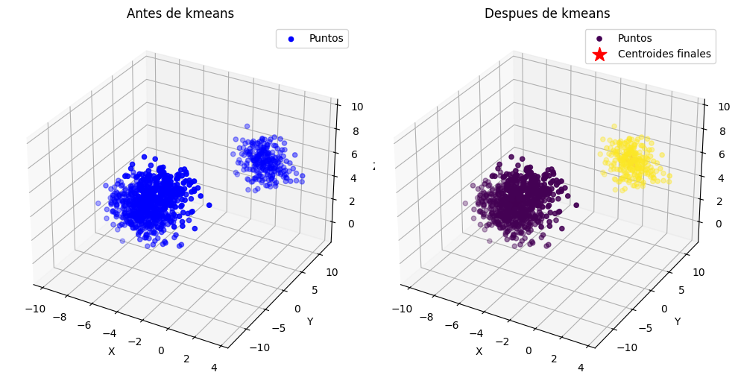
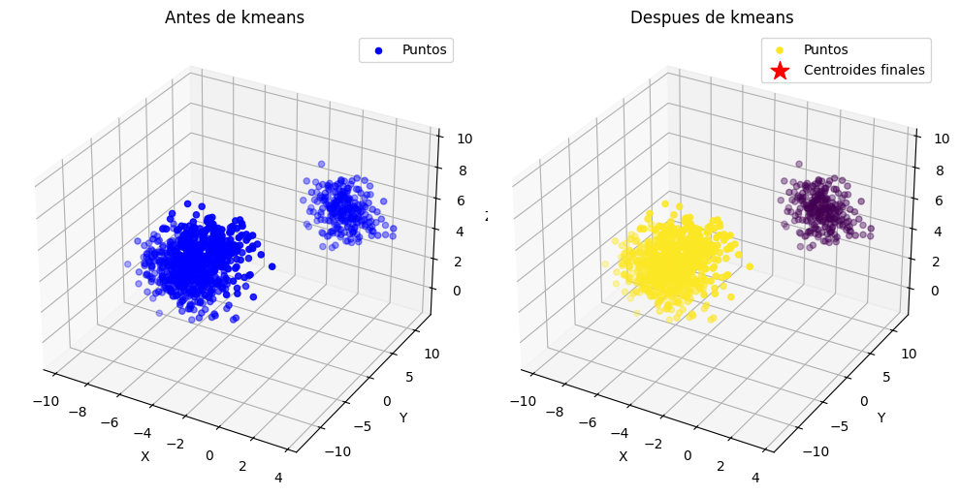
5TO PUNTO 1000 Muestras, 3D, k=2 distancia euclidiana, max iteraciones = 1000

Slide 15
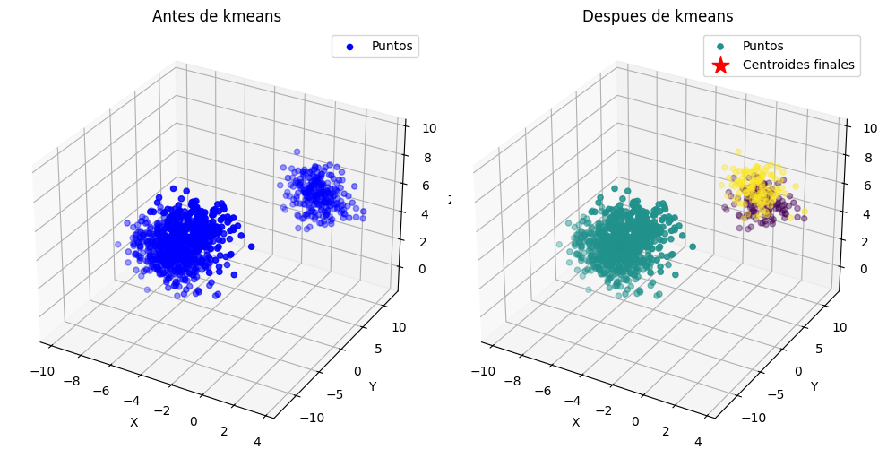
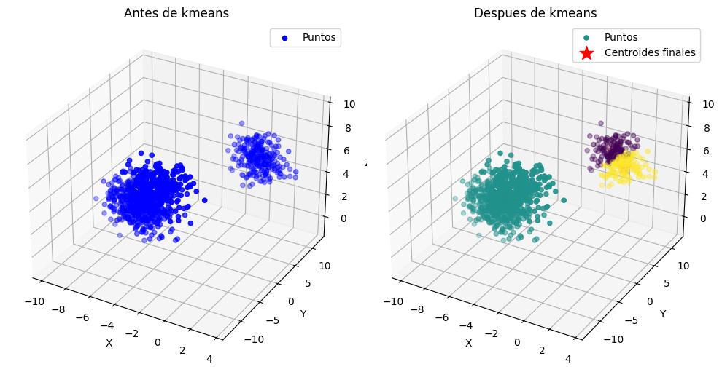
5TO PUNTO 1000 Muestras, 3D, k=3 distancia euclidiana, max iteraciones = 1000

Slide 16
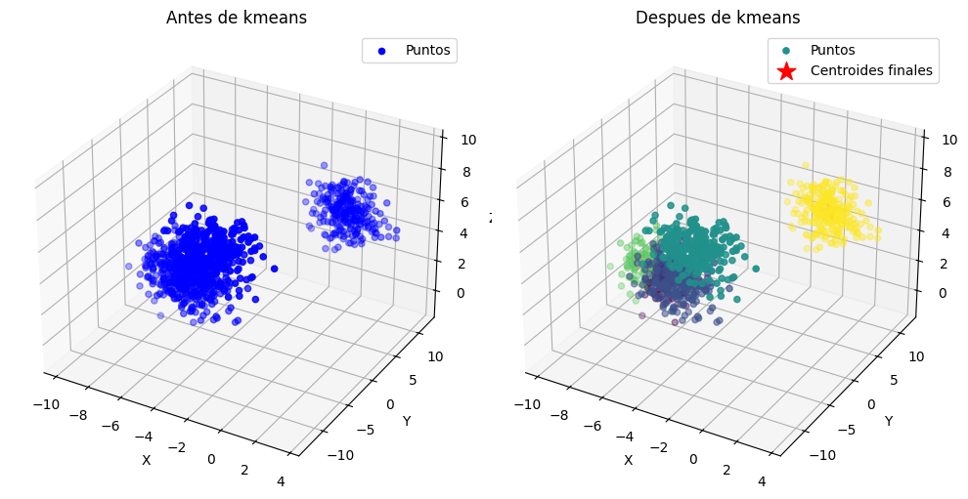
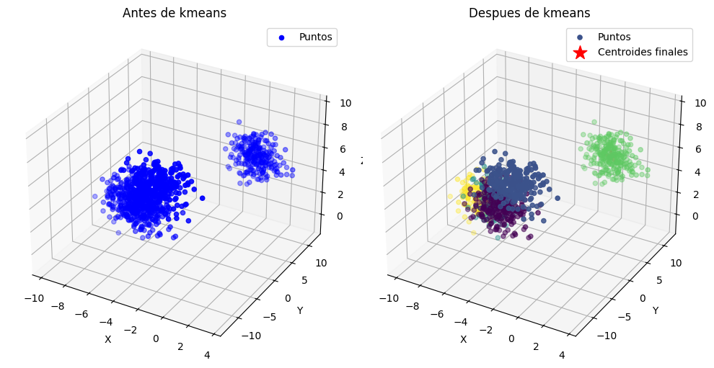
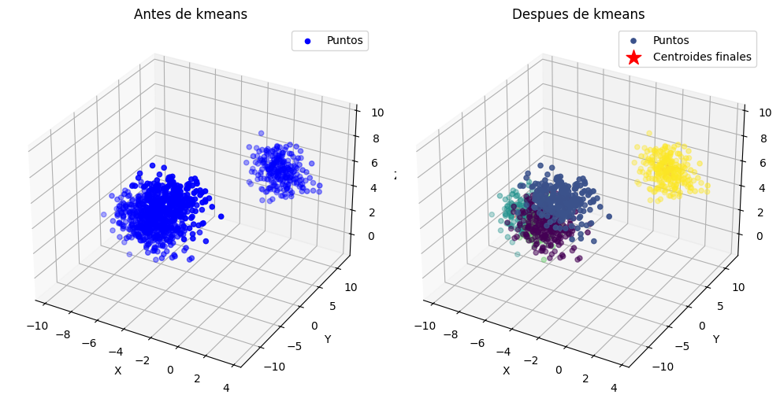
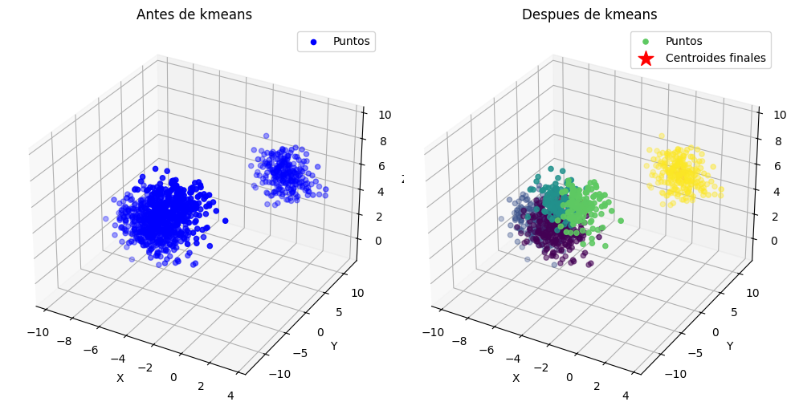
5TO PUNTO 1000 Muestras, 3D, k=5 distancia euclidiana, max iteraciones = 1000

Slide 17
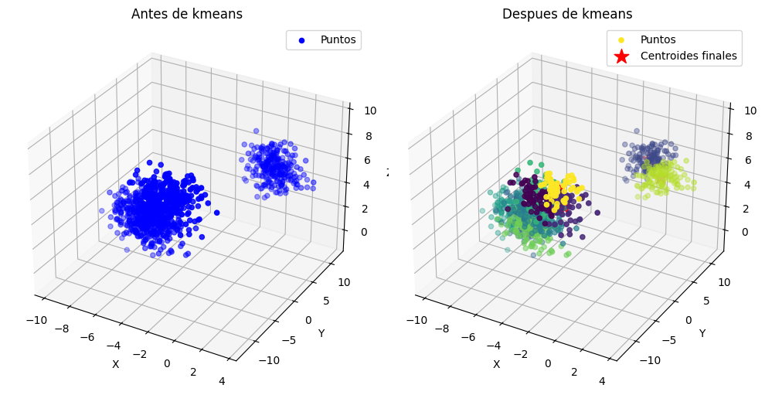
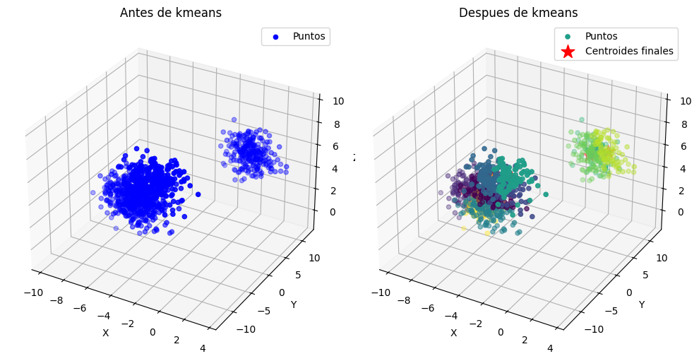
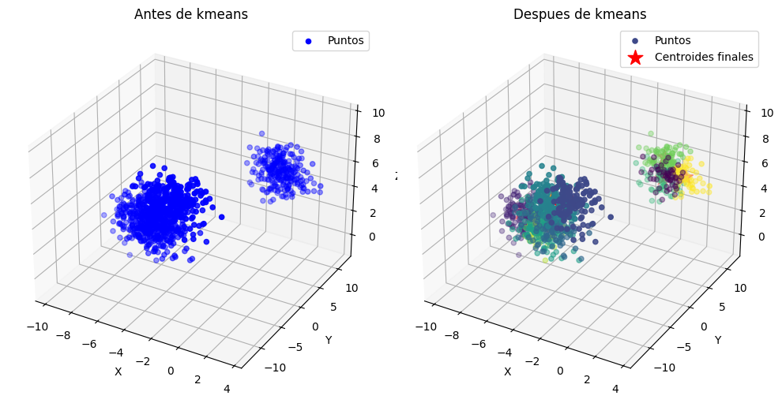
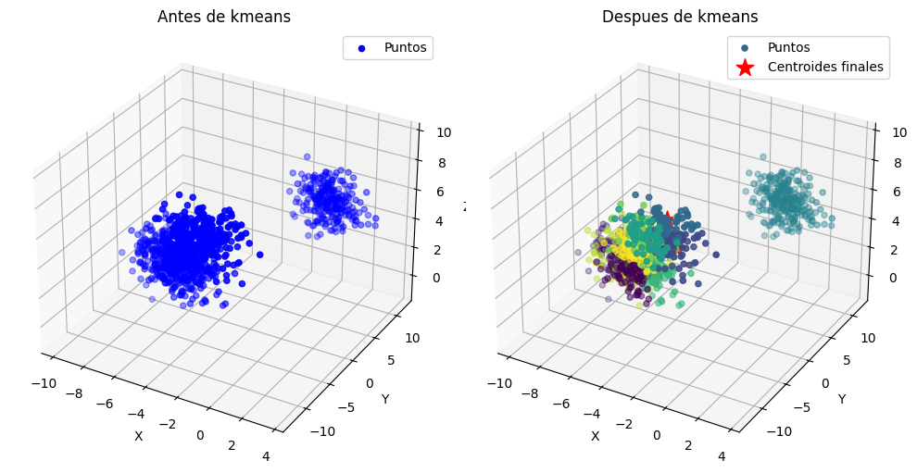
5TO PUNTO 1000 Muestras, 3D, k=10 distancia euclidiana, max iteraciones = 1000

Slide 18
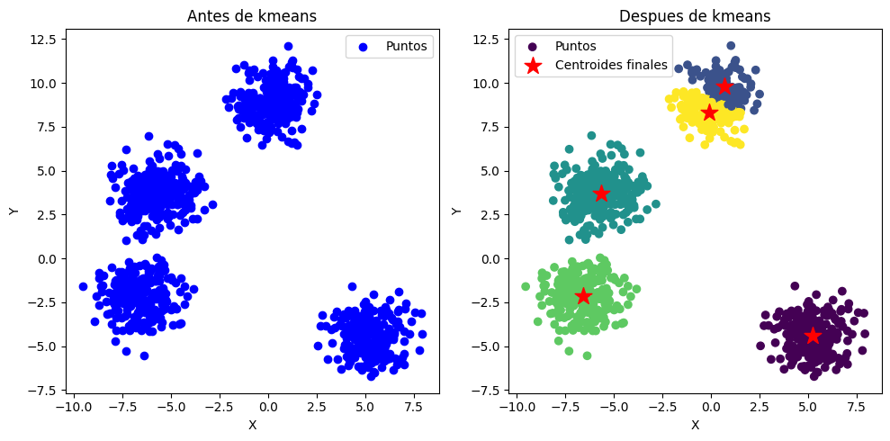
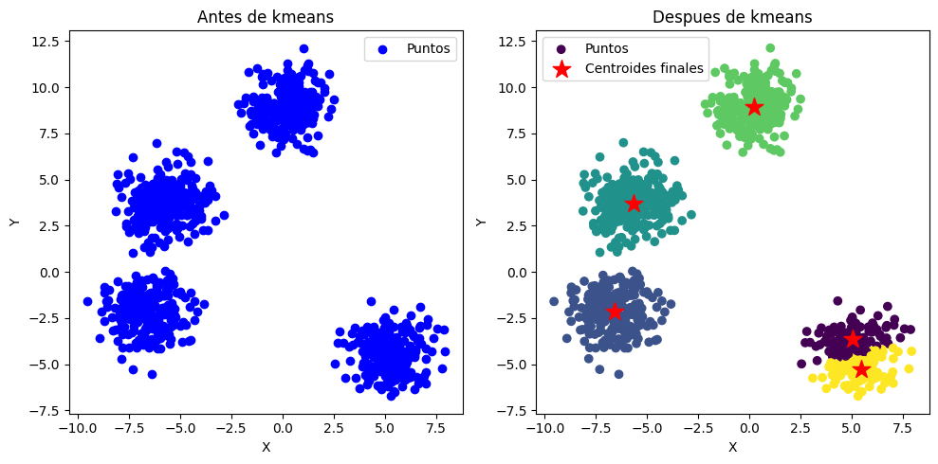
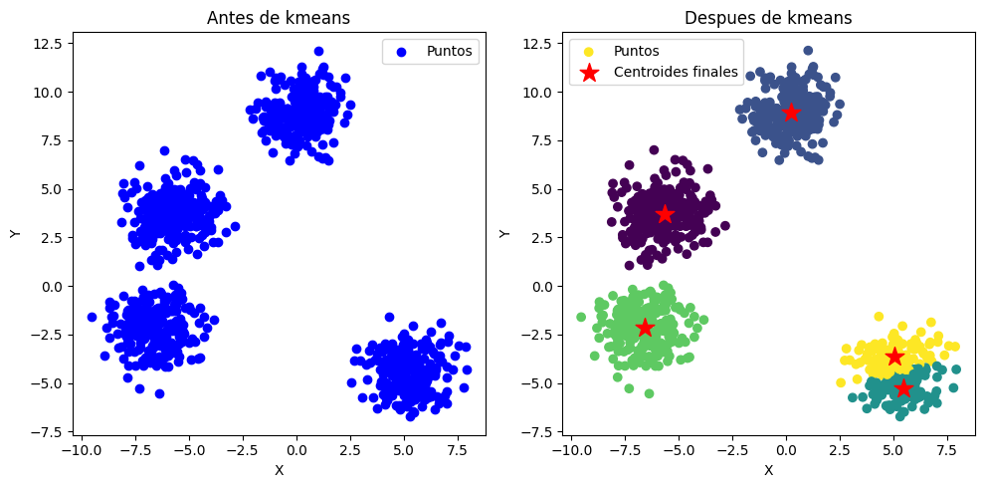
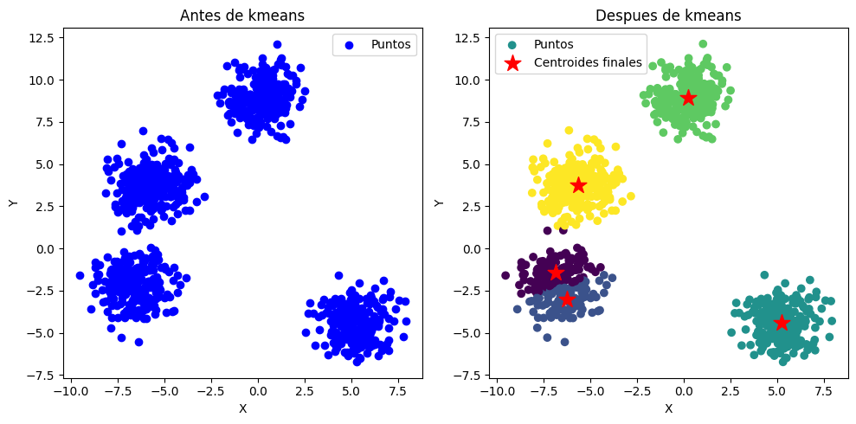
6TO PUNTO – 2D (1.000 ITERACIONES)
Distancia Euclidiana

Slide 19
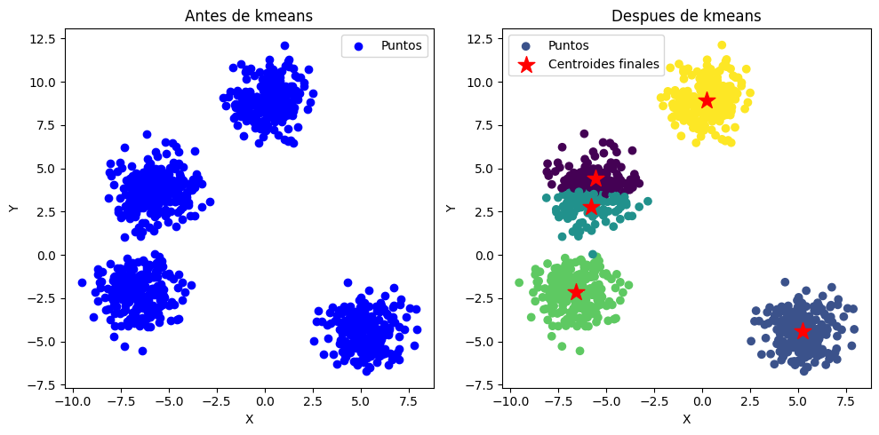
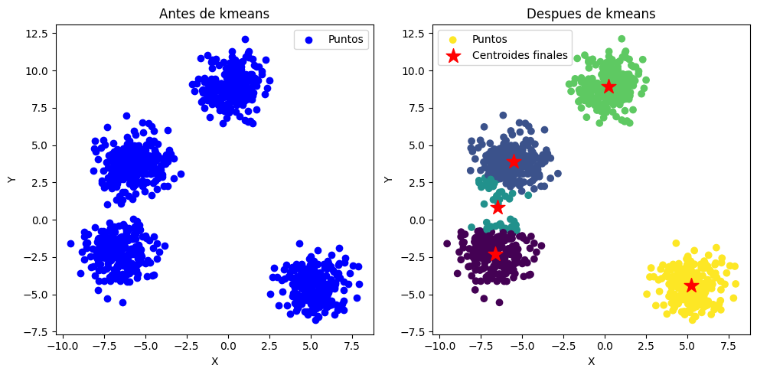
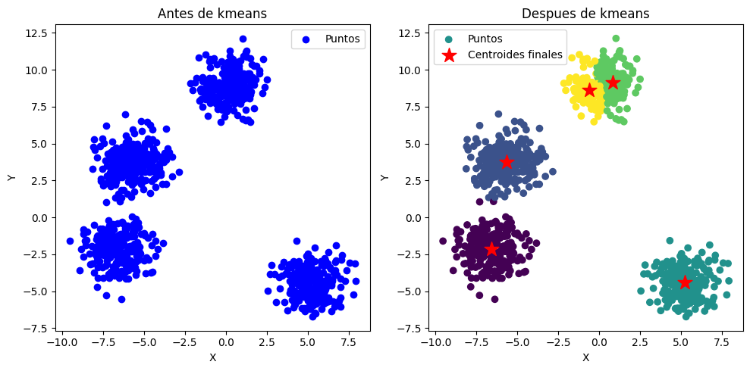
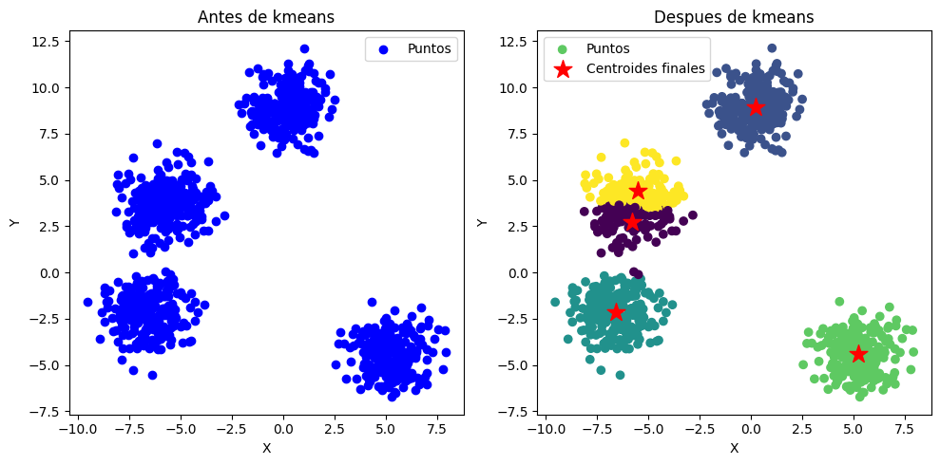
6TO PUNTO – 2D (1.000 ITERACIONES)
Distancia Manhattan

Slide 20
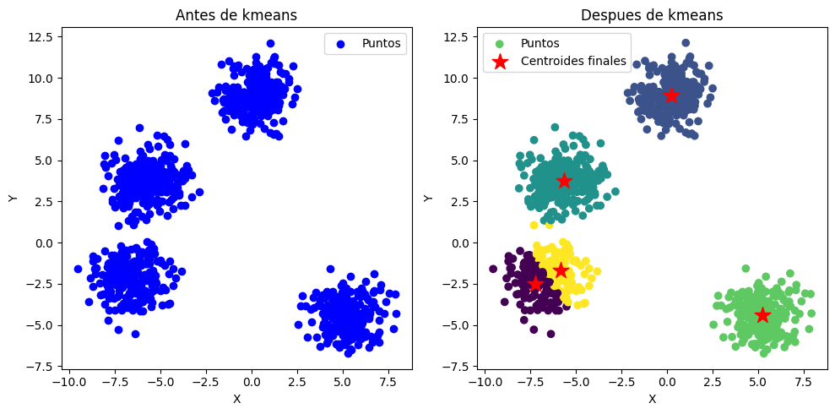
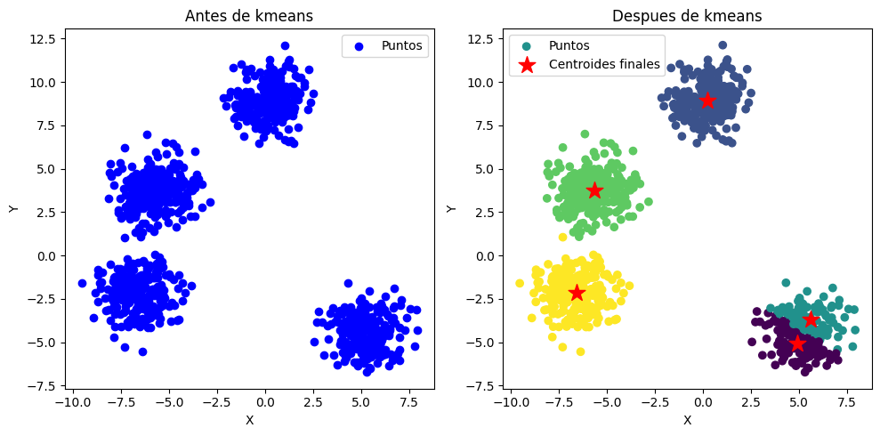
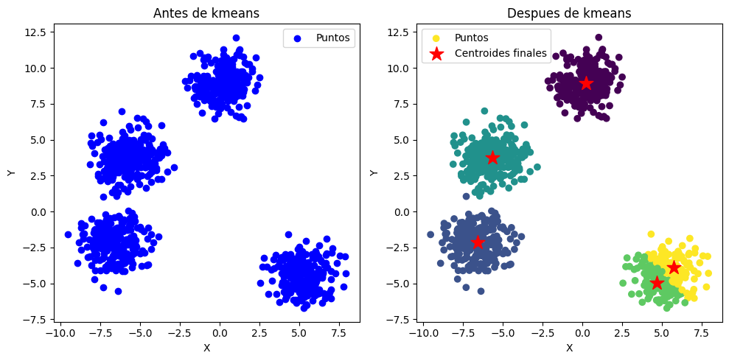
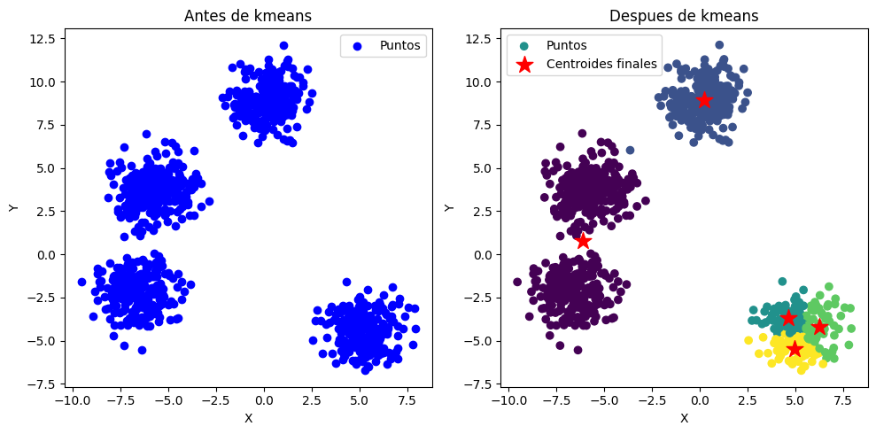
6TO PUNTO – 2D (1.000 ITERACIONES)
Distancia Mahalanobis

Slide 21
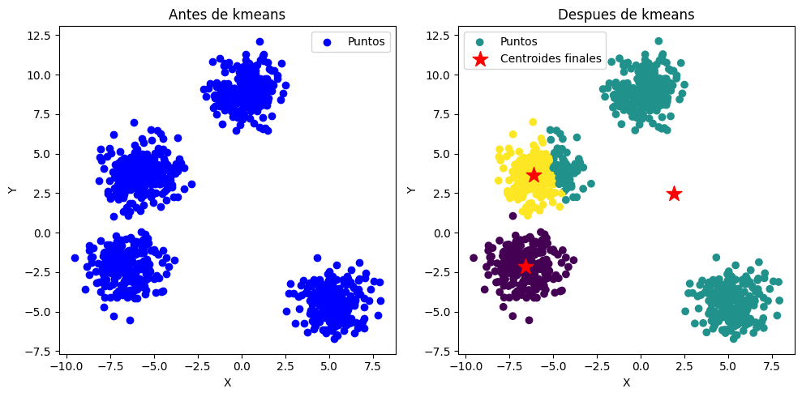
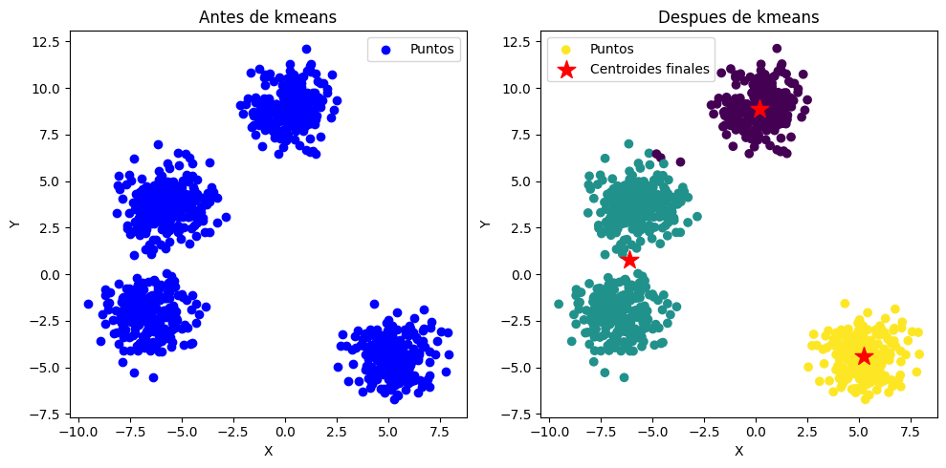
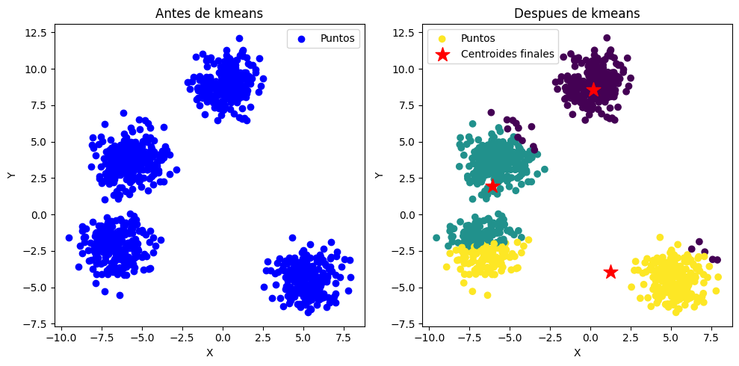


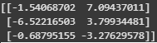
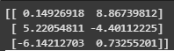
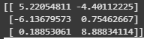
7MO PUNTO – Buscando punto de convergencia del punto 1
1 ITERACION
10 ITERACION
20 ITERACION

Slide 22
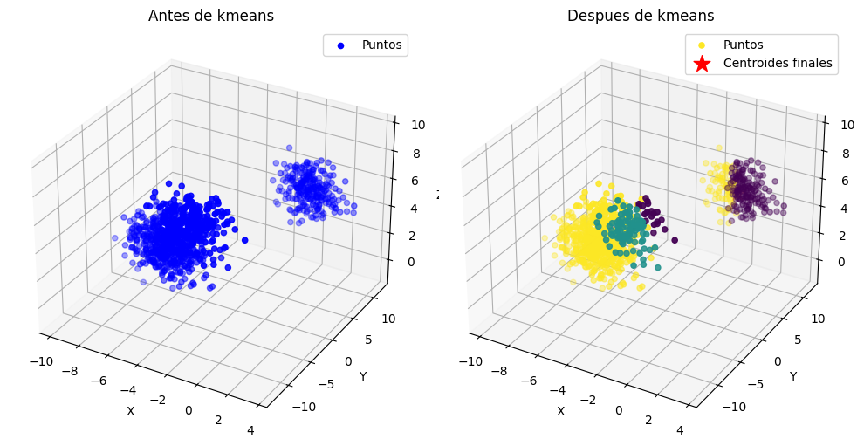
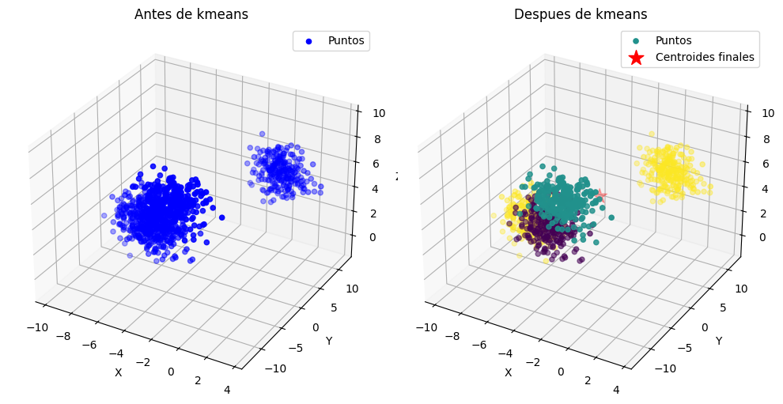
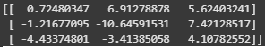
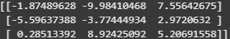
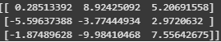
7MO PUNTO – Buscando punto de convergencia del punto 2
1 ITERACION
10 ITERACION
20 ITERACION

Slide 23






7MO PUNTO – Buscando punto de convergencia del punto 3
1000 Muestras, 3D, k=10 distancia euclidiana, max iteraciones = 1
1000 Muestras, 3D, k=10 distancia euclidiana, max iteraciones = 20
1000 Muestras, 3D, k=10 distancia euclidiana, max iteraciones = 10

Slide 24


7MO PUNTO – Buscando punto de convergencia del punto 5 K=2
1000 Muestras, 3D, k=2 distancia euclidiana, max iteraciones = 1
1000 Muestras, 3D, k=2 distancia euclidiana, max iteraciones = 20
1000 Muestras, 3D, k=2 distancia euclidiana, max iteraciones = 10

Slide 25


7MO PUNTO – Buscando punto de convergencia del punto 5 K=3
1000 Muestras, 3D, k=3 distancia euclidiana, max iteraciones = 1
1000 Muestras, 3D, k=3 distancia euclidiana, max iteraciones = 20
1000 Muestras, 3D, k=3 distancia euclidiana, max iteraciones = 10

Slide 26









7MO PUNTO – Buscando punto de convergencia del punto 5 K=5
1000 Muestras, 3D, k=5 distancia euclidiana, max iteraciones = 100
1000 Muestras, 3D, k=5 distancia euclidiana, max iteraciones = 100000
1000 Muestras, 3D, k=5 distancia euclidiana, max iteraciones = 1000

Slide 27









7MO PUNTO – Buscando punto de convergencia del punto 5 K=10
1000 Muestras, 3D, k=5 distancia euclidiana, max iteraciones = 10000
1000 Muestras, 3D, k=5 distancia euclidiana, max iteraciones = 100000
1000 Muestras, 3D, k=5 distancia euclidiana, max iteraciones = 1000000

Slide 28









7MO PUNTO – Buscando punto de convergencia del punto 6 Euclidiana
1 ITERACION
5 ITERACION
10 ITERACION

Slide 29









7MO PUNTO – Buscando punto de convergencia del punto 6 manhattan
1 ITERACION
5 ITERACION
10 ITERACION

Slide 30









7MO PUNTO – Buscando punto de convergencia del punto 6 manhattan
1 ITERACION
5 ITERACION
10 ITERACION

